Slide 1


Slide 2
Benefits for Members!
Membership Drive Exceeded 80 Members!
Digital Clio Area Directory: Free Listing with Membership
Printed Clio Area Directory: Free Listing with Membership
Clocktower: FREE 1 Week Posting of Business per year
Facebook: FREE Posting of Business on our Facebook Page
Meeting: FREE 1 Month in “Spotlight”
Sponsorship Opportunities: Extensive Listing of Events/Projects in the community you can support and get recognition
Sponsorship Listing & Posting: Your events can get listed and promoted by the Chamber
Your Dues help support Community Events (Fireworks, Candlelite Nite, and much, much more!)

Slide 3


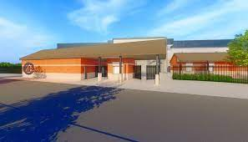
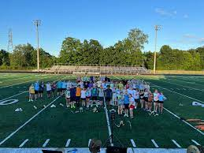


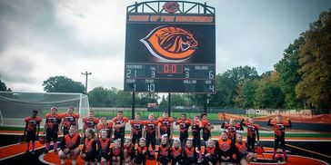
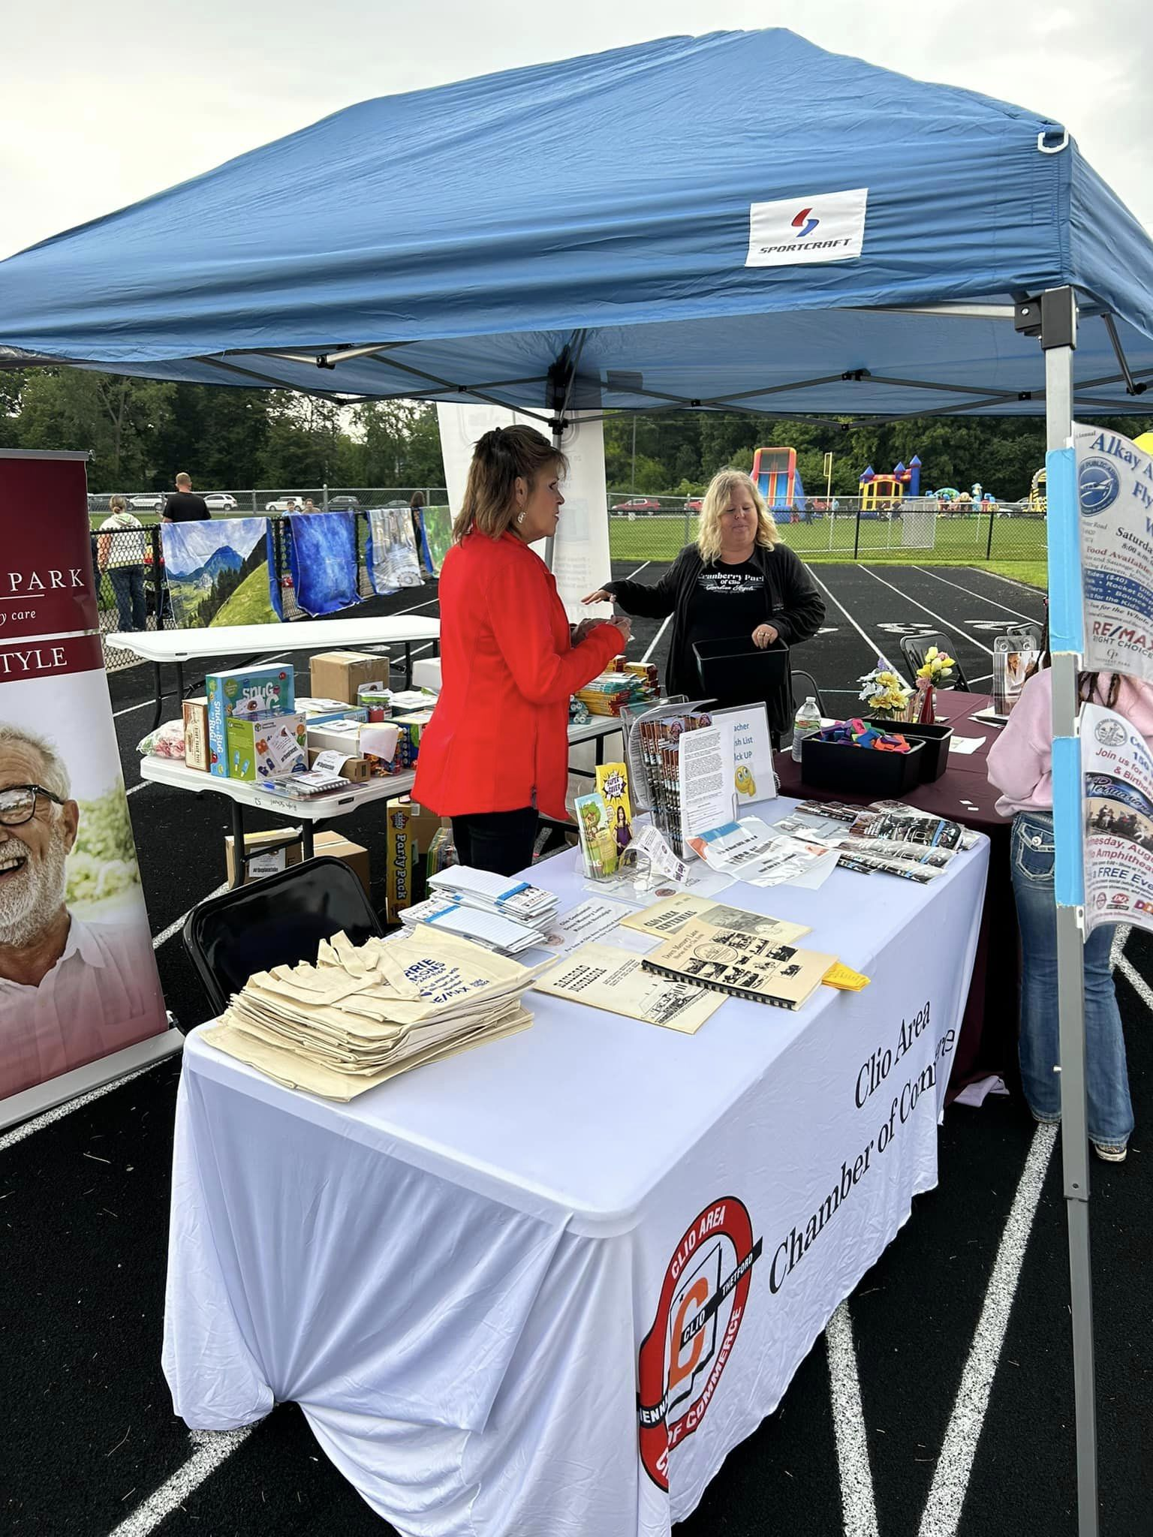

And much,
much
MORE!

Slide 4
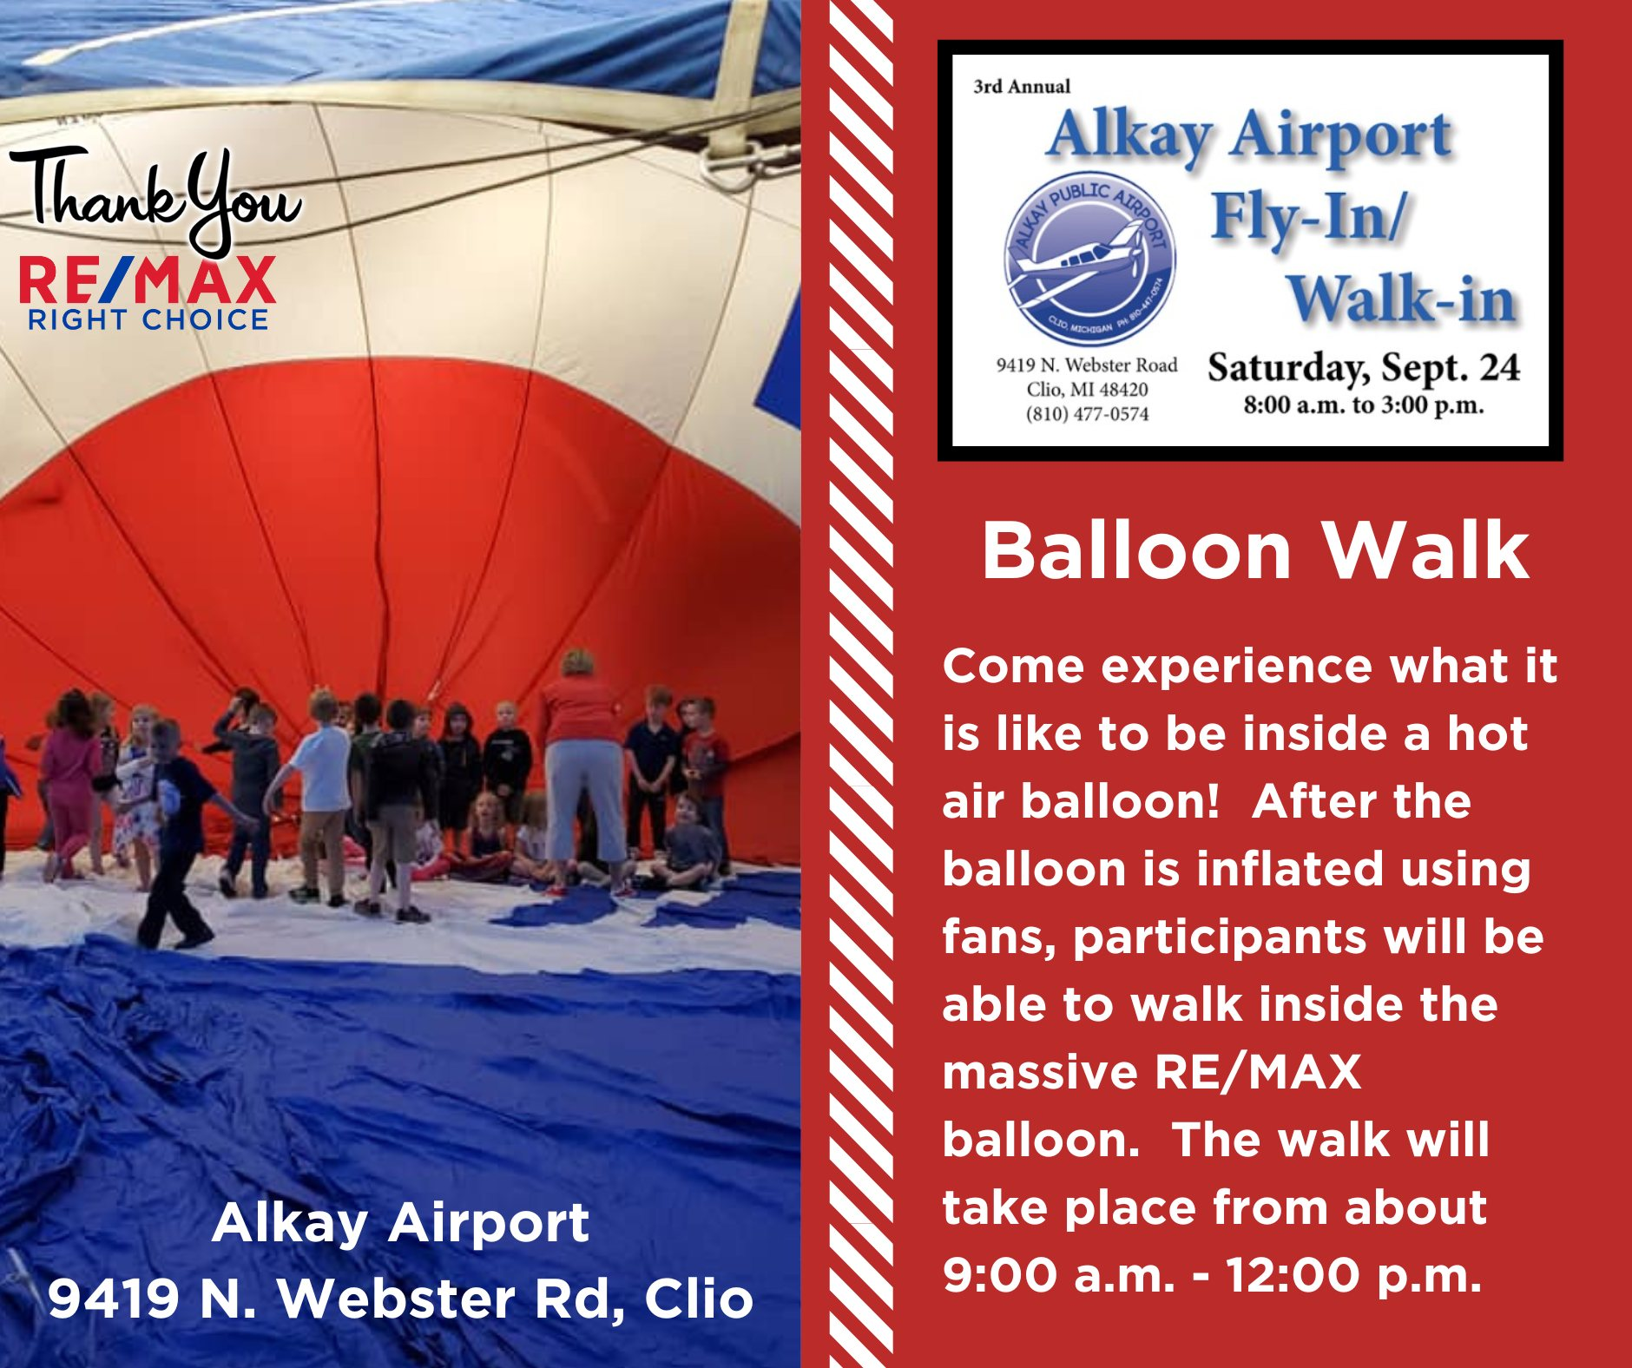



ALKAY AIRPORT FLY-IN/WALK-In
Sept. 14 8 AM – 3 PM

Slide 5
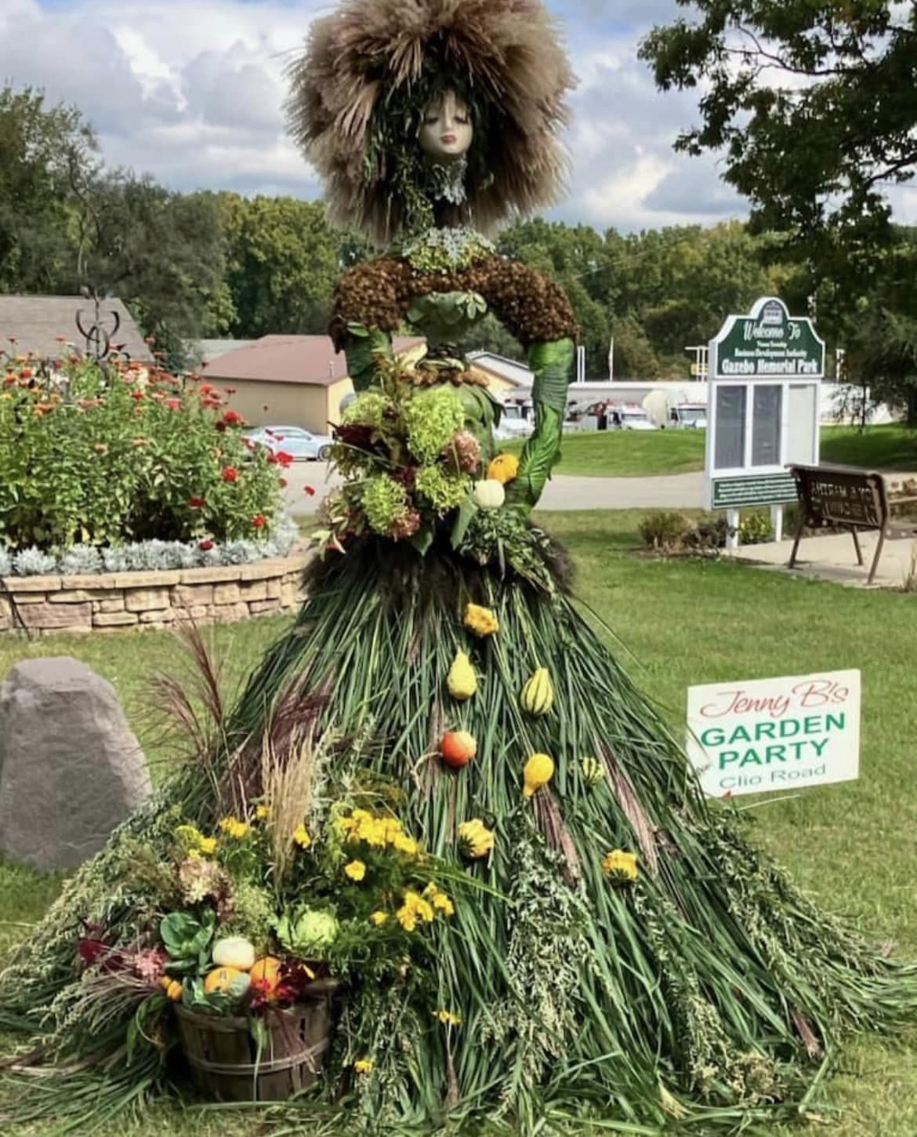
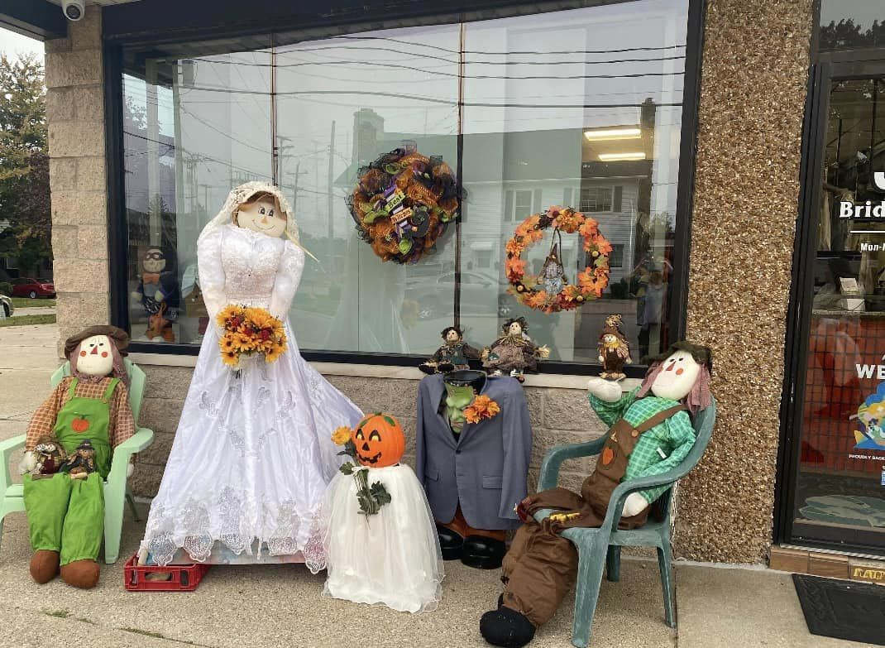

RETURNING THIS AUTUMN!
Scarecrow Invasion…

Slide 6

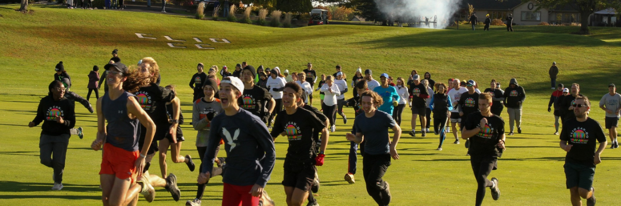
5K Color Run
October 12, 2024
Clio Country Club

Slide 7


Be Looking forward to these events….

Slide 8

And this one…
December 6

Slide 9
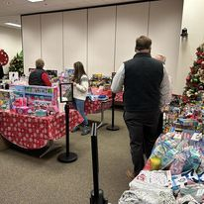

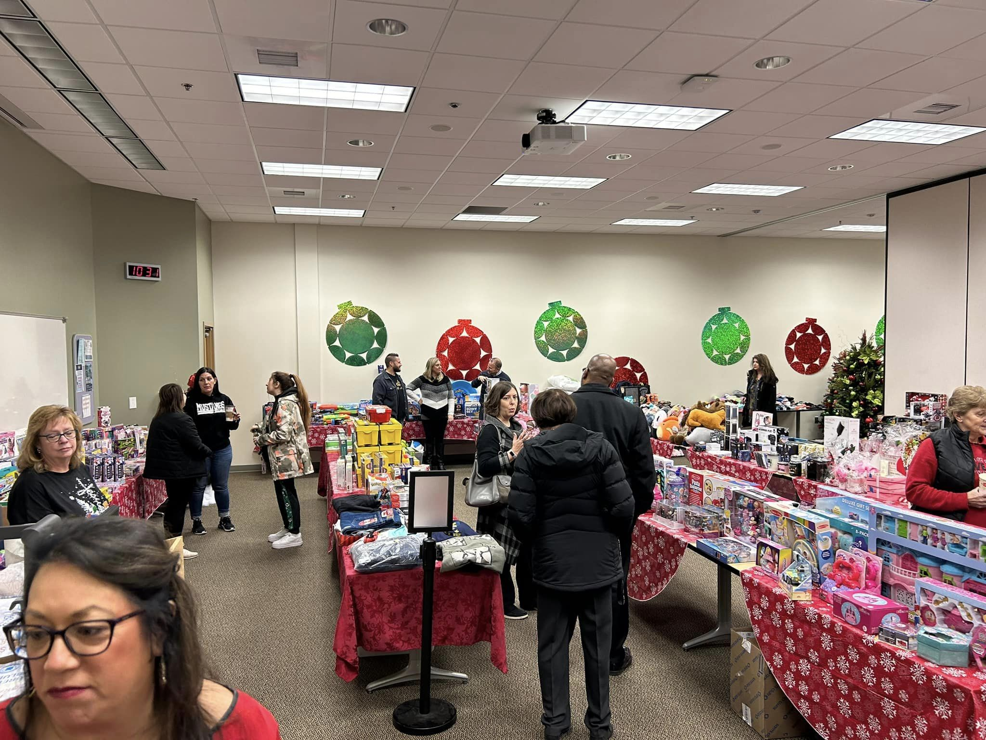
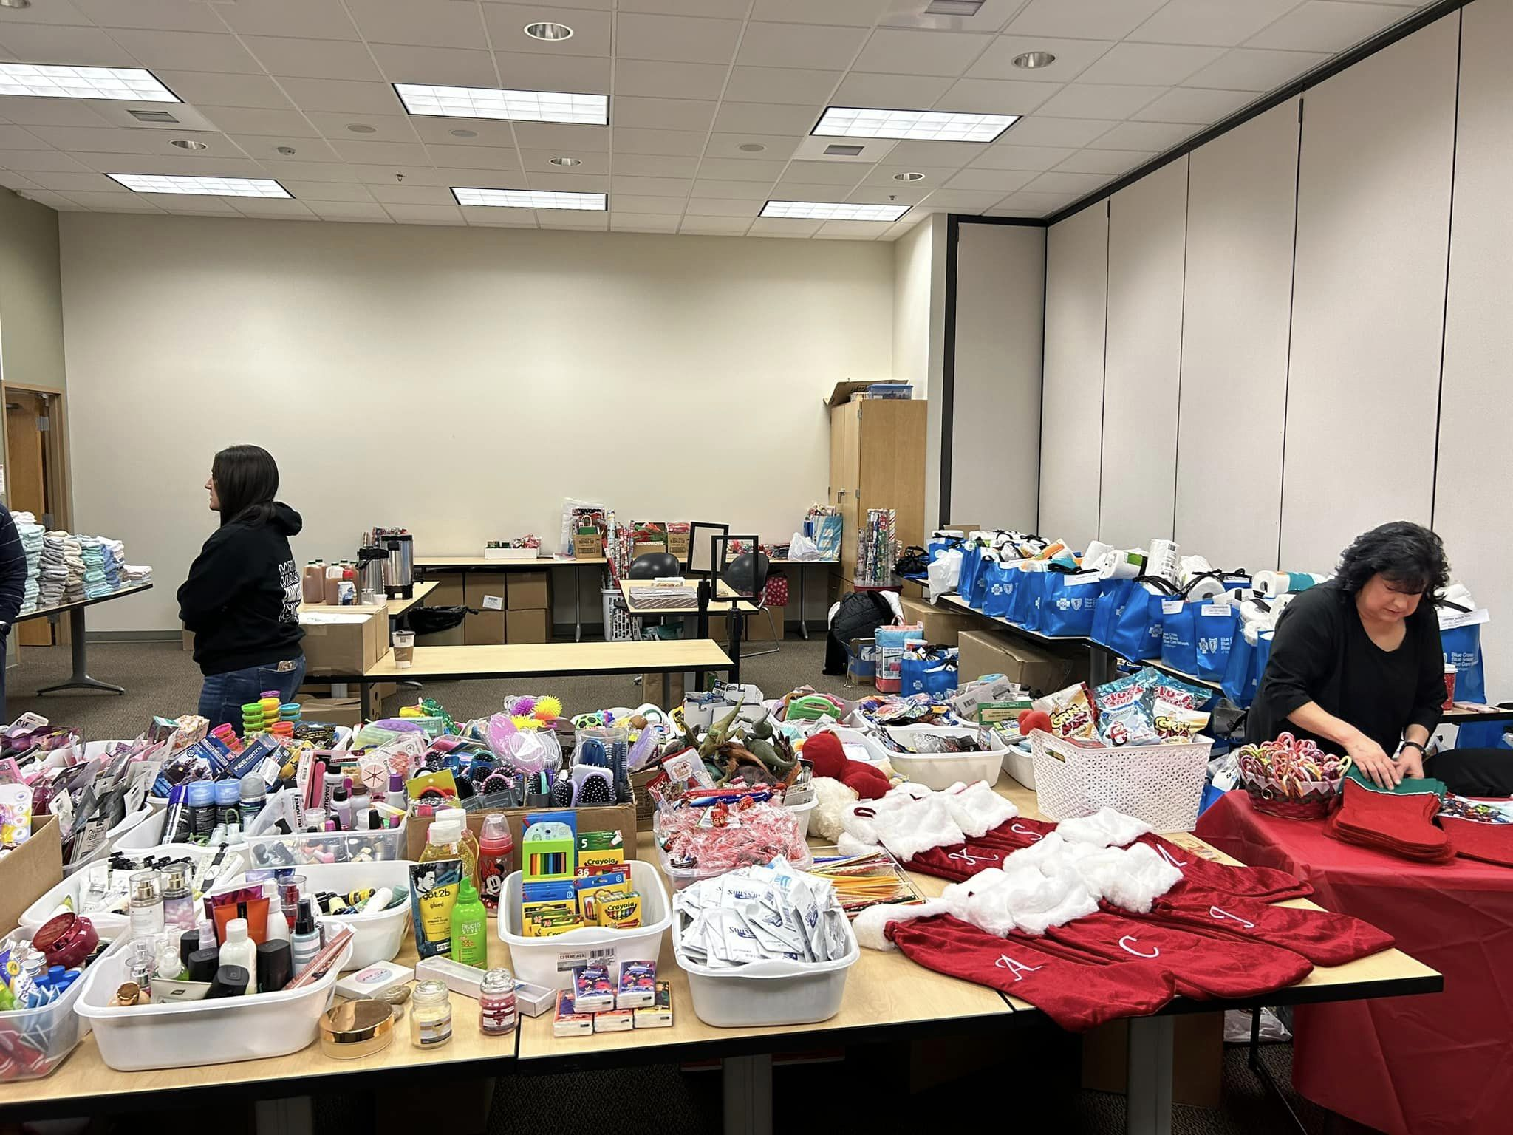
December 13, 14
24

Slide 10
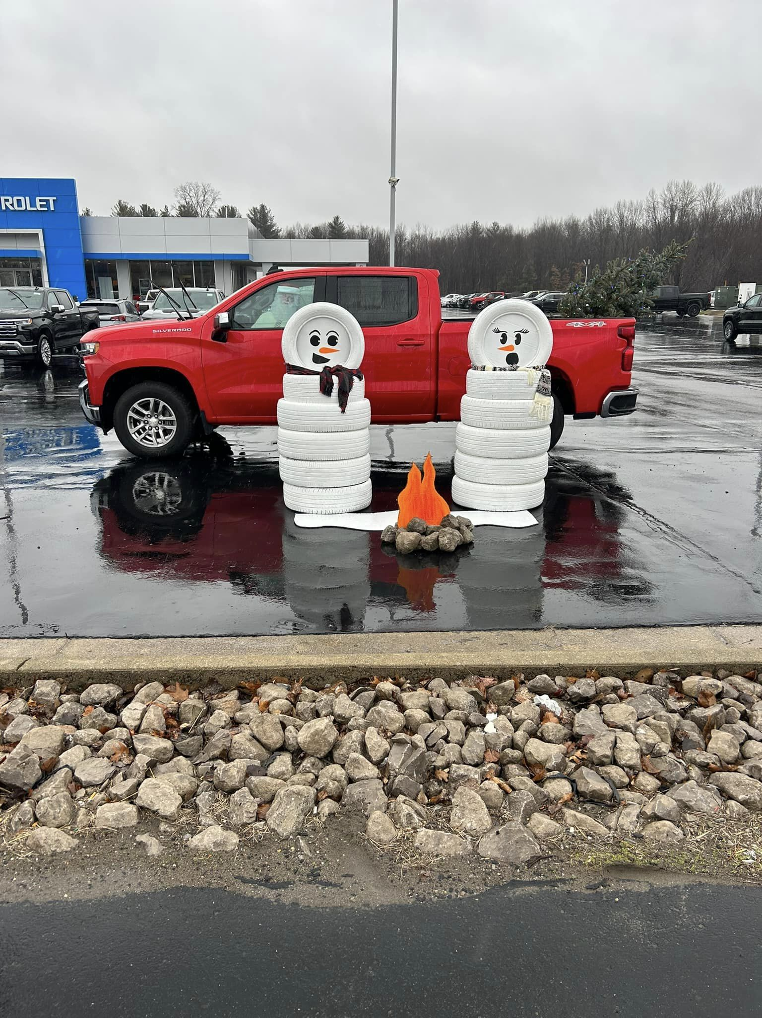
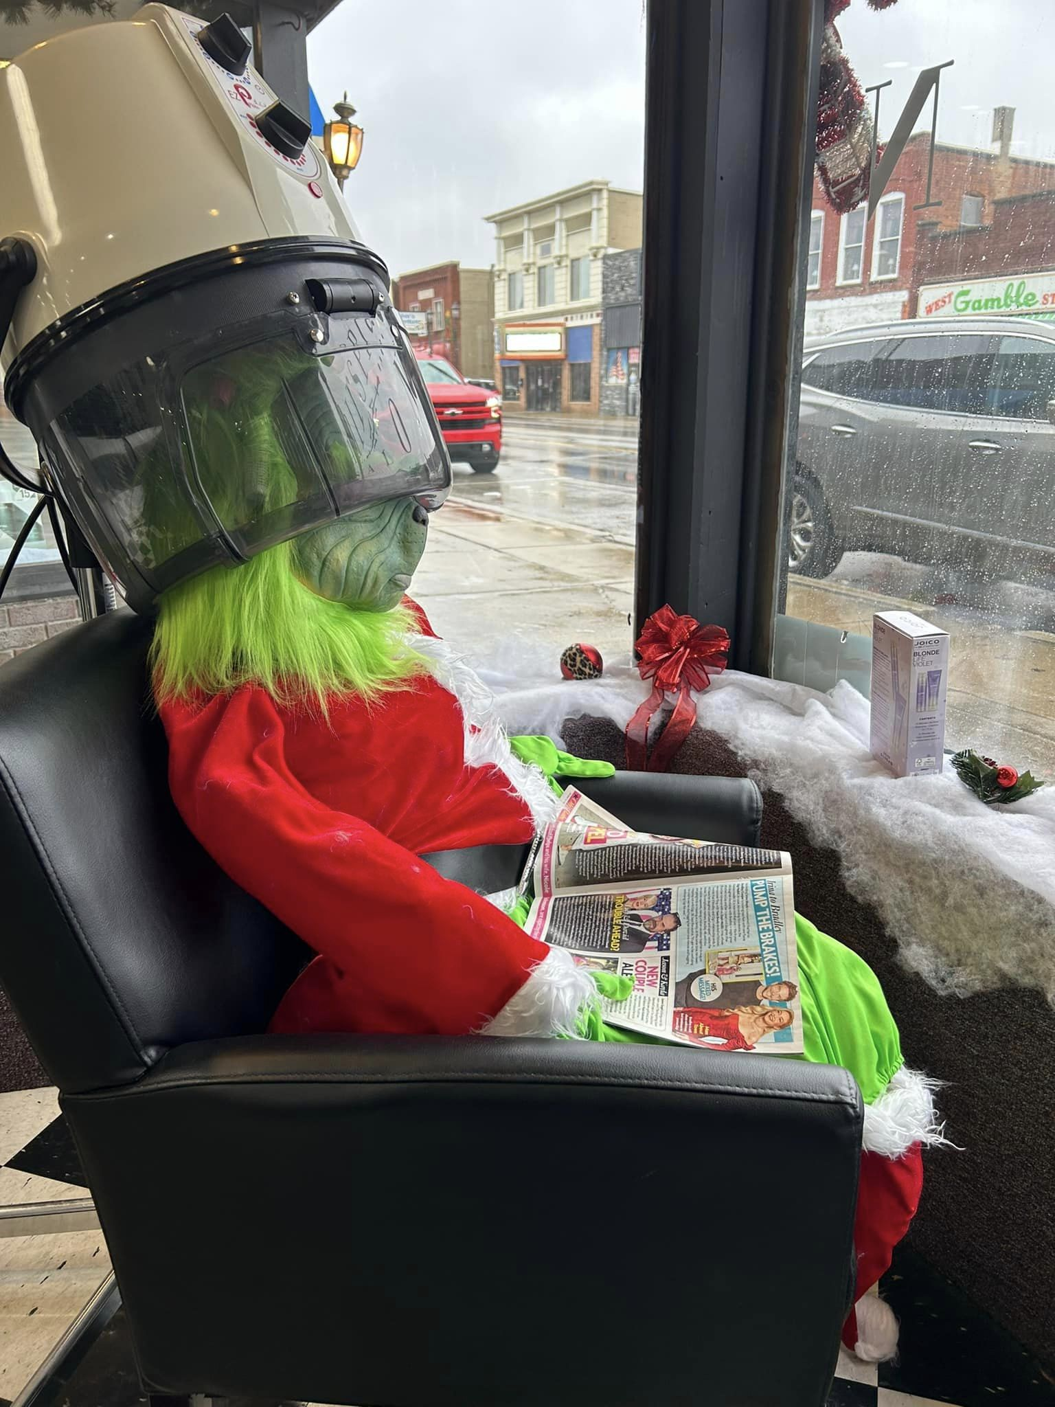
Scenes of the Season 2…

Slide 11

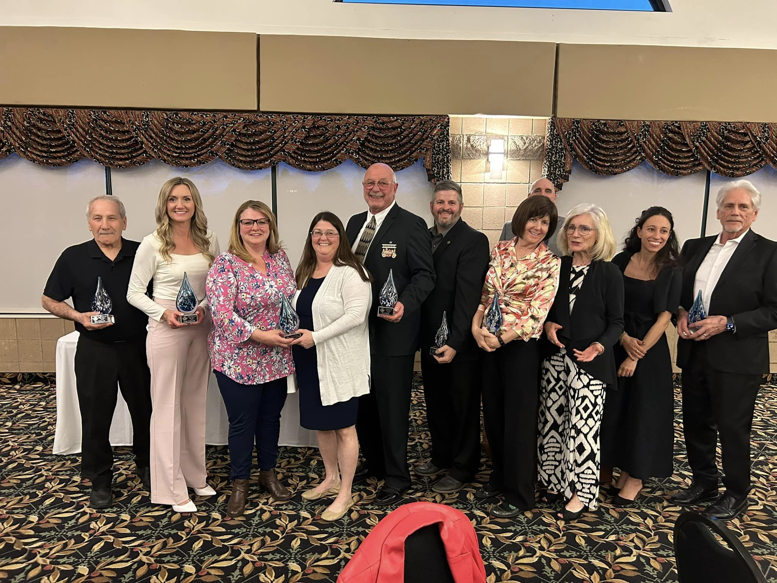

Slide 12
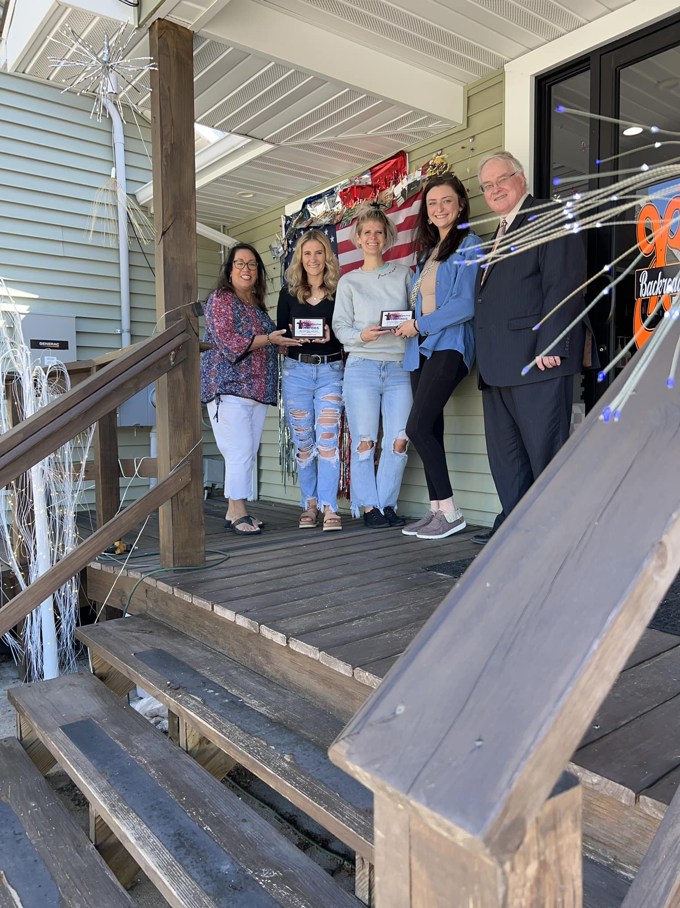

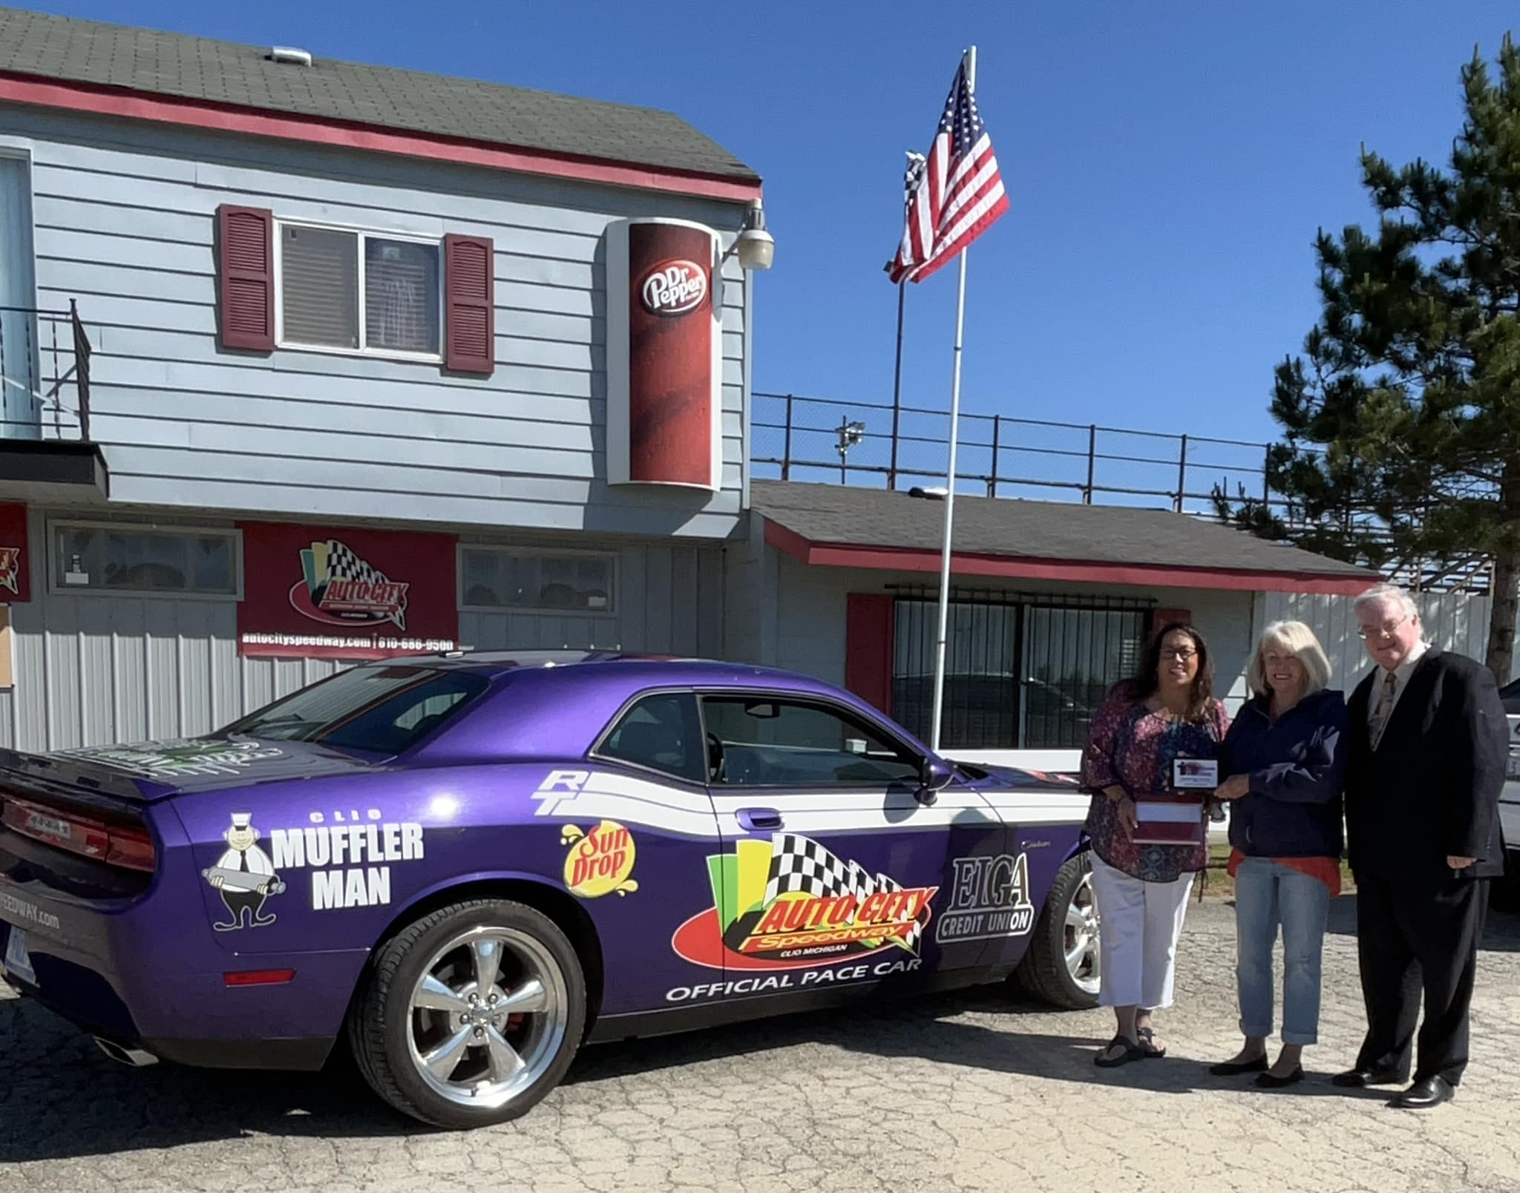

Slide 13

Summer Contest– Highlighting Local Business!

Slide 14
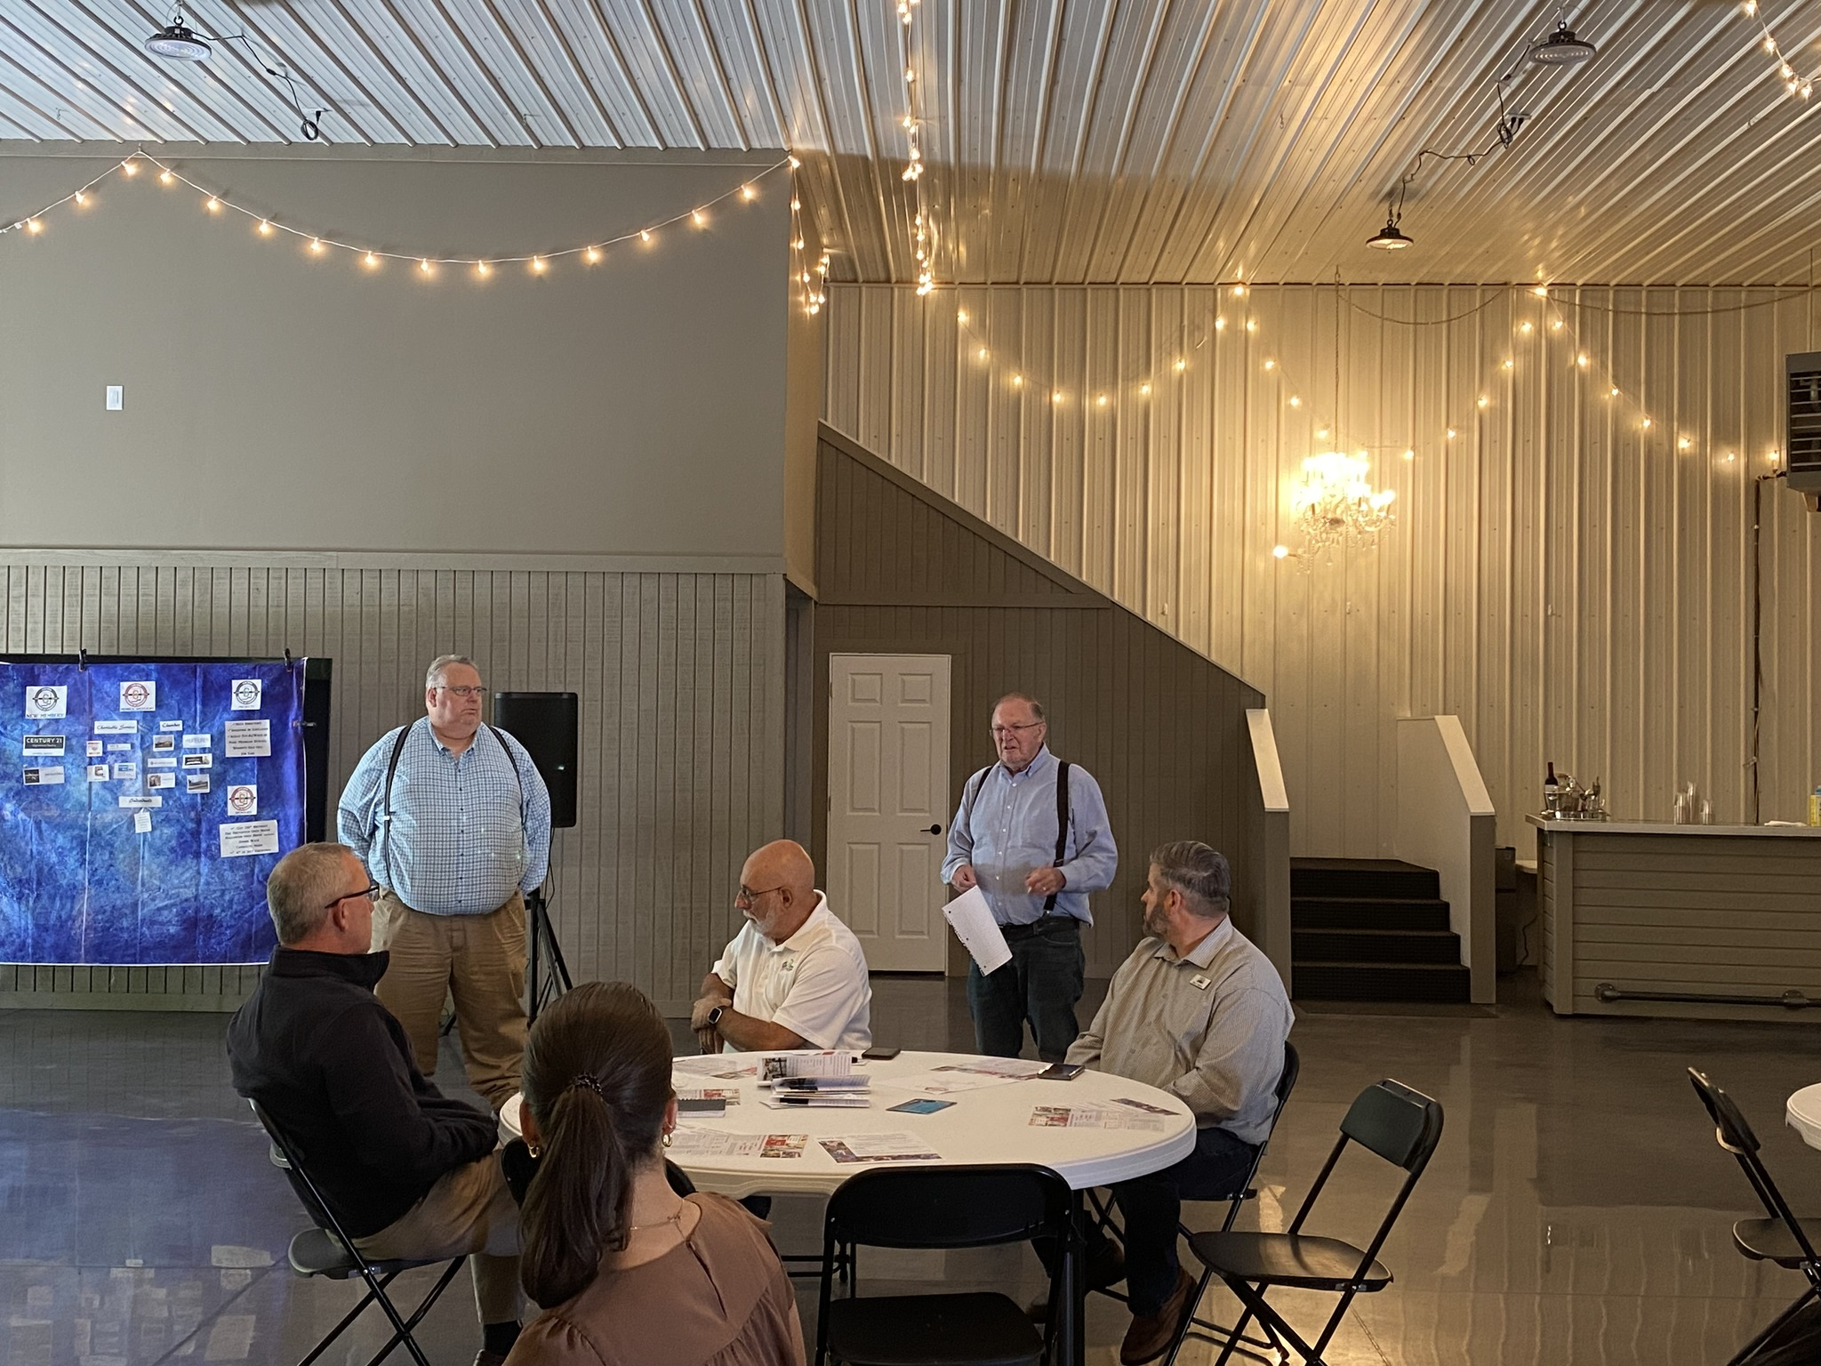
Next Luncheon:
Sept. 12 Noon Bella Venue
Program: News from City & Township

