Slide 1


Slide 2

Paper
Pencils
Pens
Markers
Crayons
Much, much, more!

Slide 3
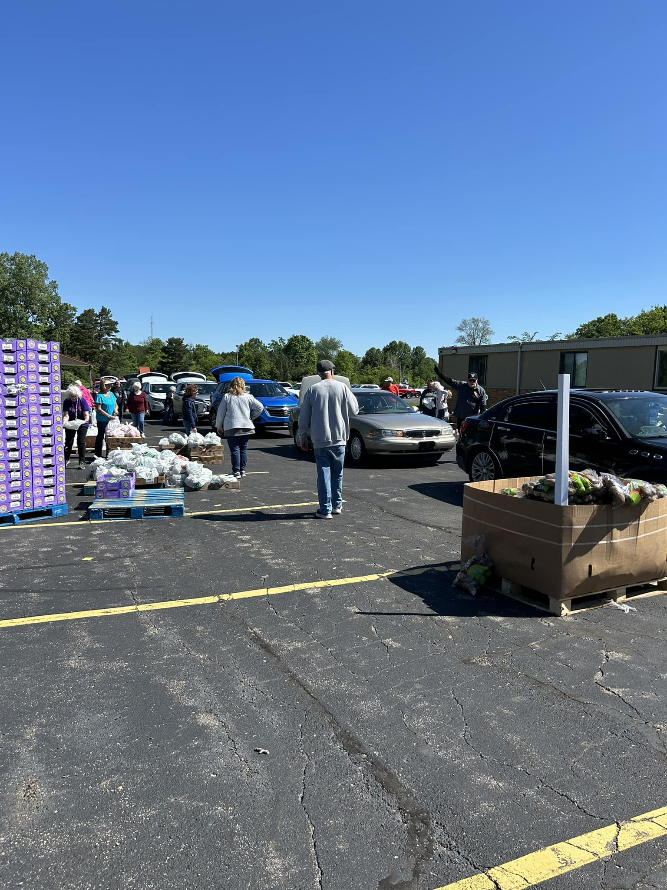
Food Distributions:
Bethany United Methodist
Community Church of God
Community of Christ
St. Charles & Helena
Clio Human Services Fund

Slide 4


Slide 5
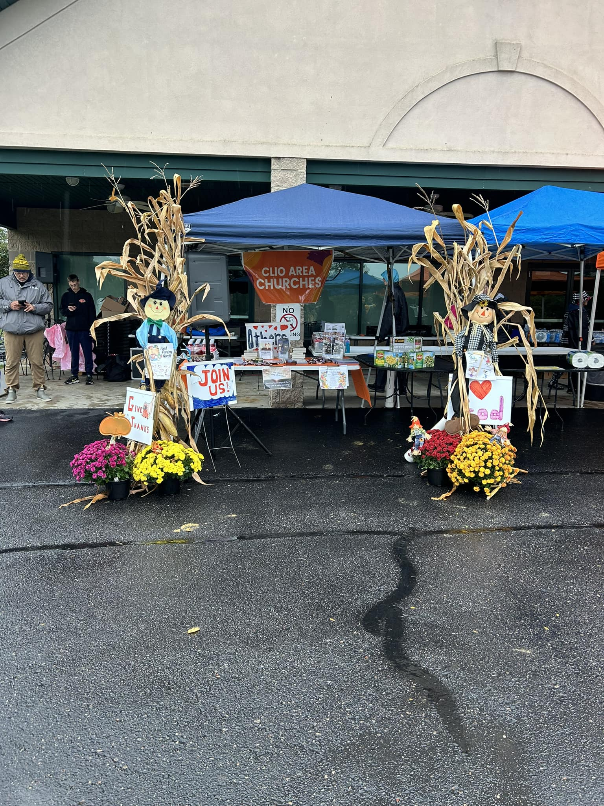

Coming:
October 12

Slide 6
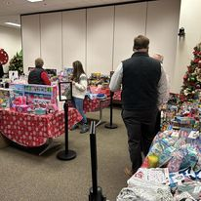

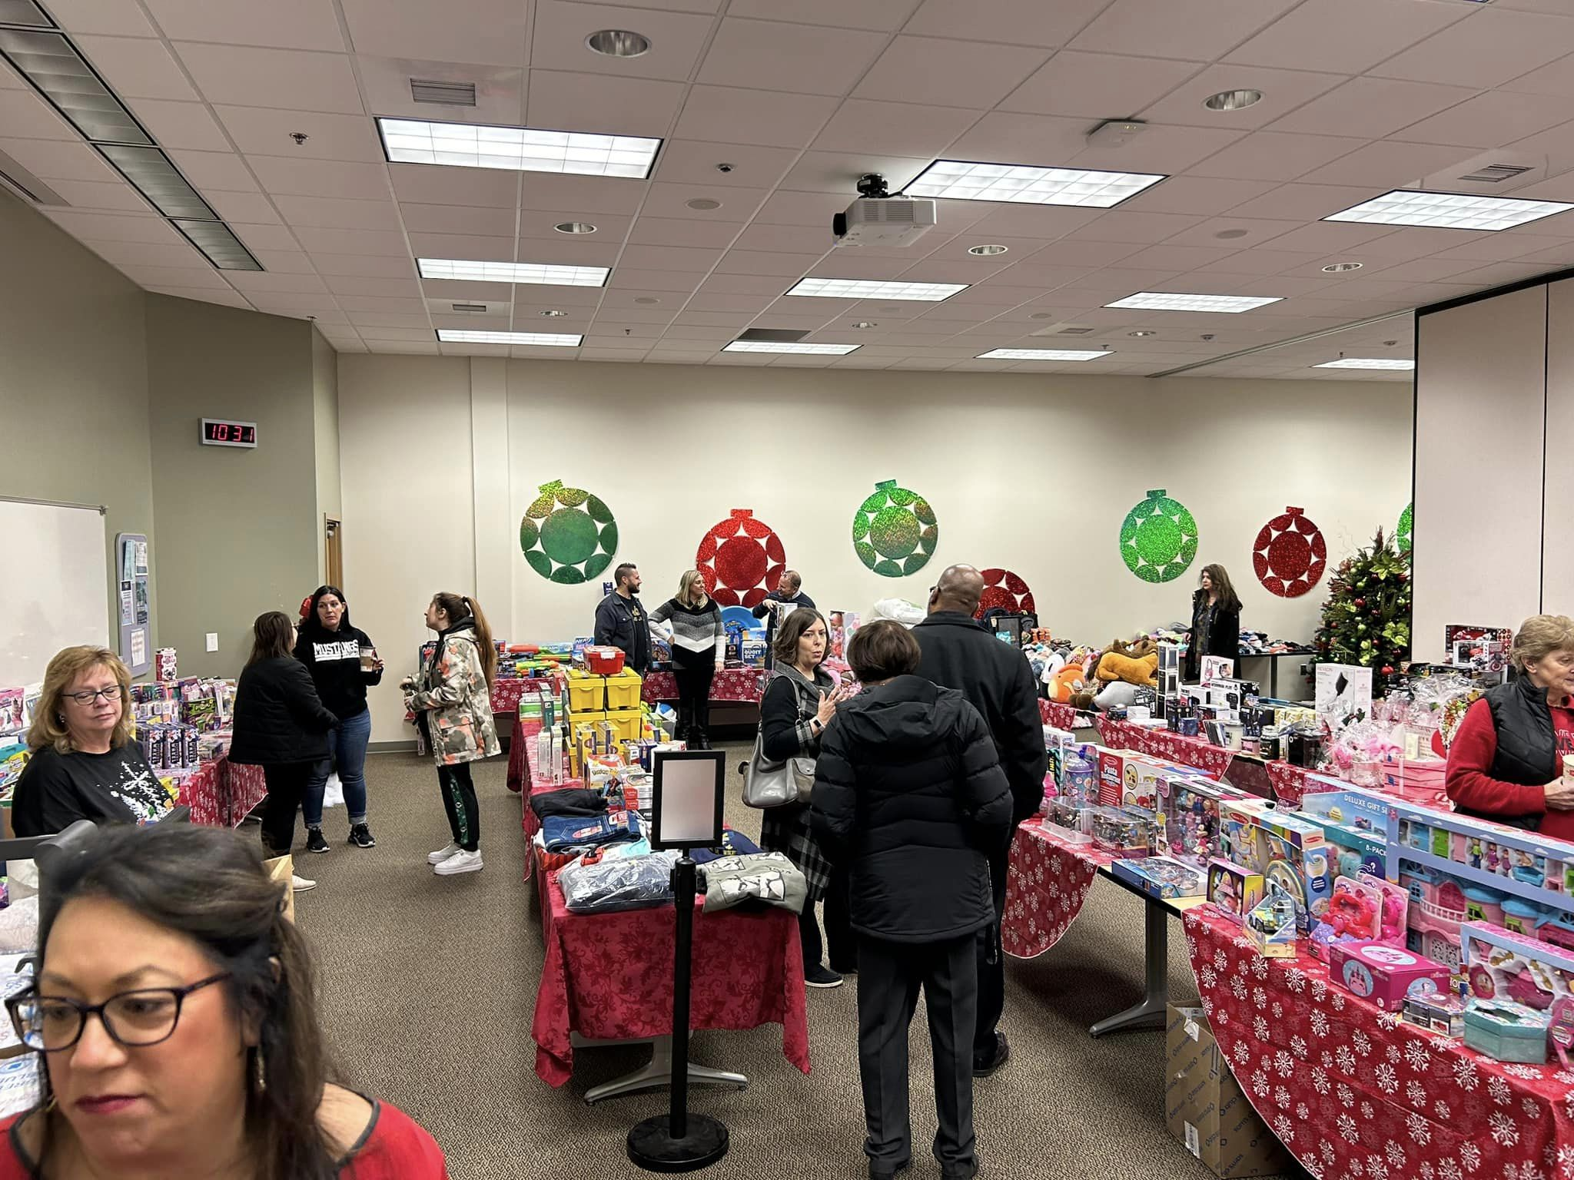
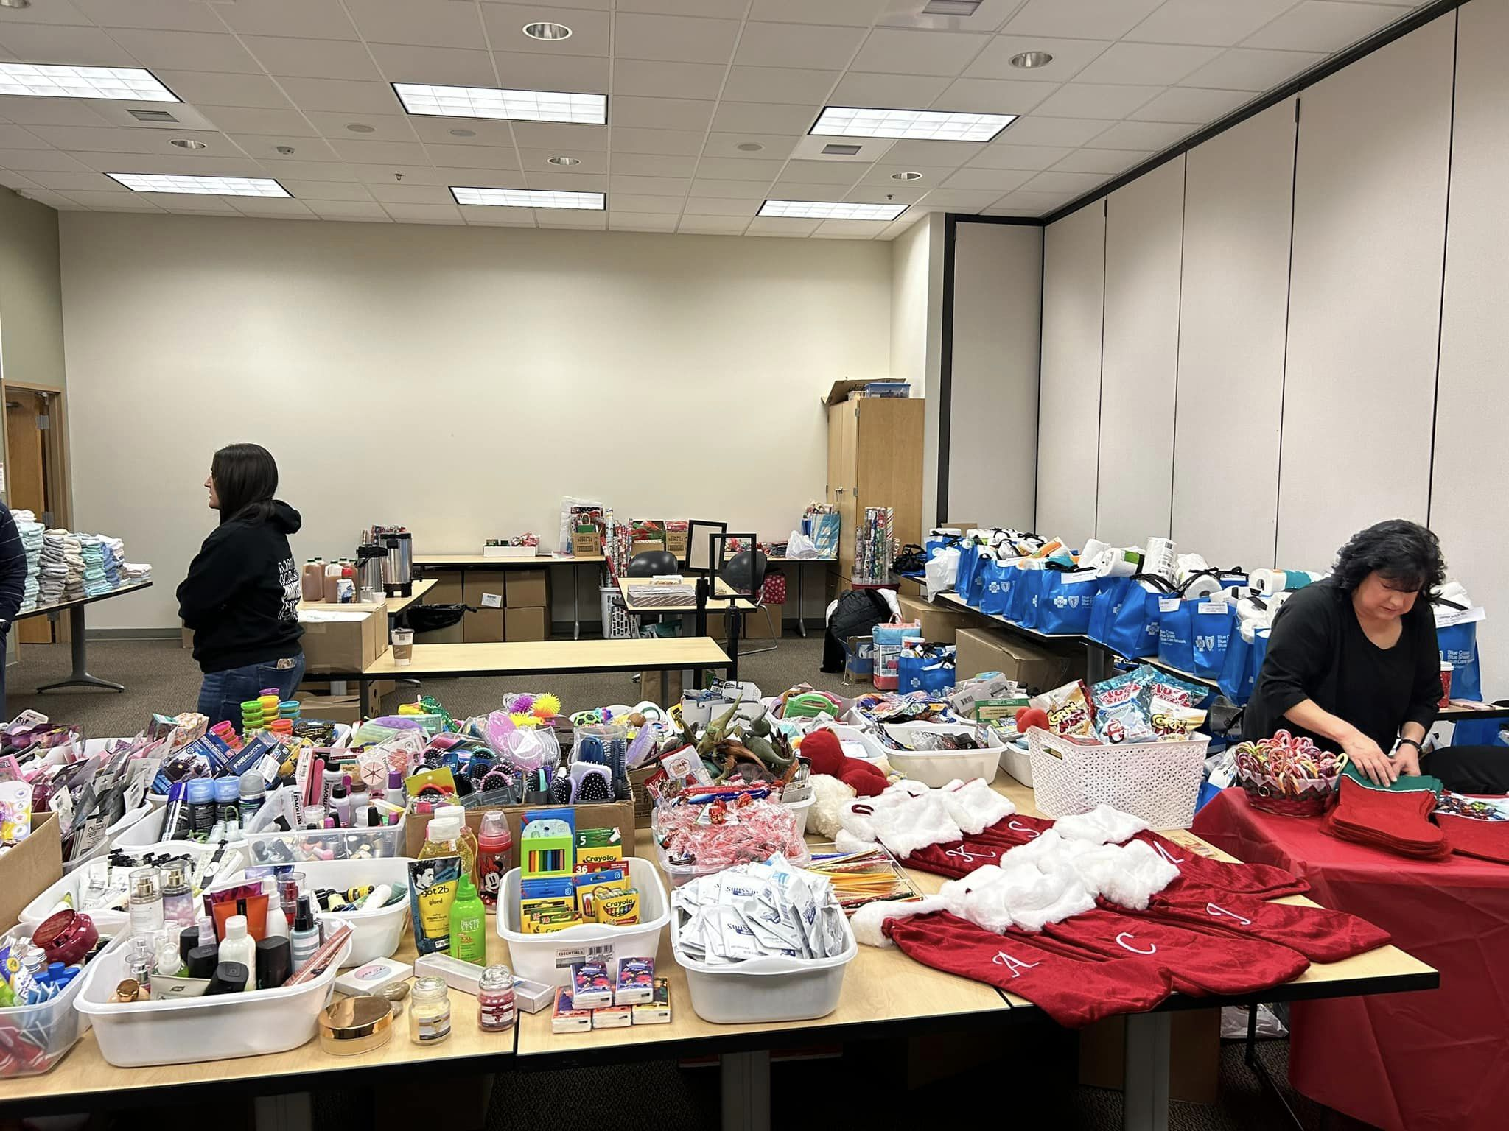
December 13, 14
24

Slide 7


Slide 8
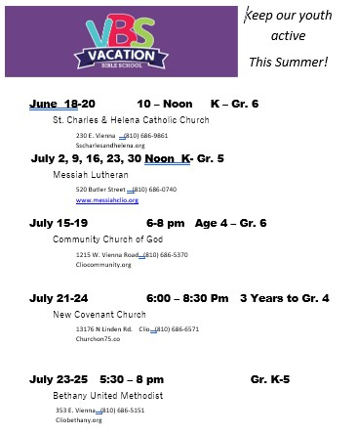

Slide 9

Join Us!

