Slide 1


Slide 2
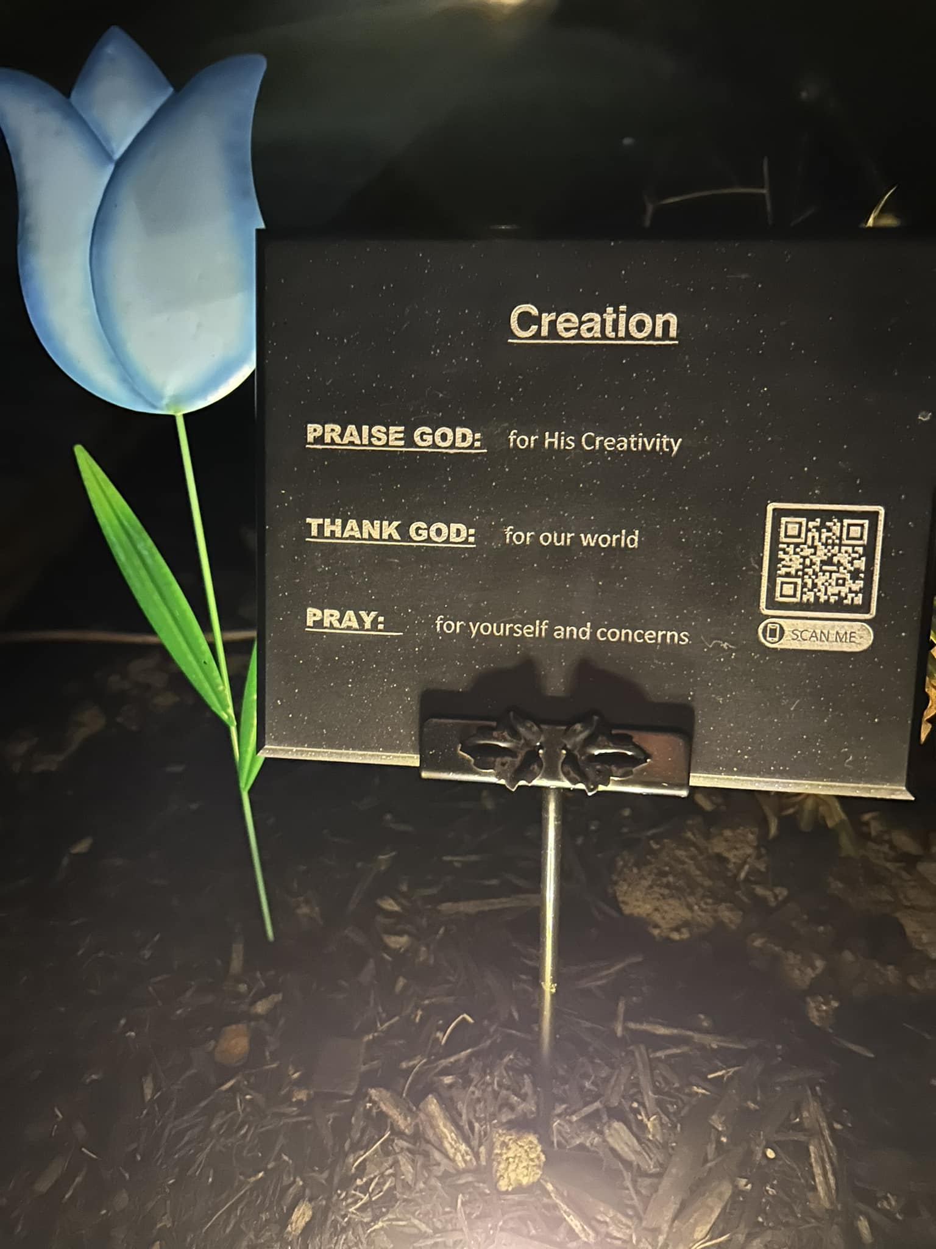
In the beginning was the Word and the Word was with God and the Word was God. He was with God in the beginning. Through Him were all things made; without Him nothing was made that has been made.
John 1:1-3

Slide 3
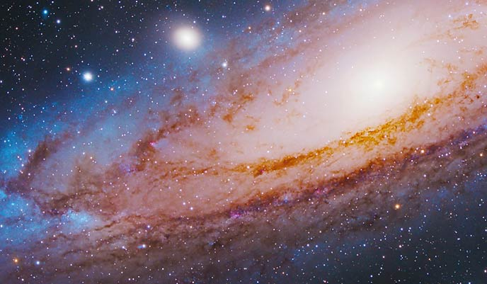

Slide 4
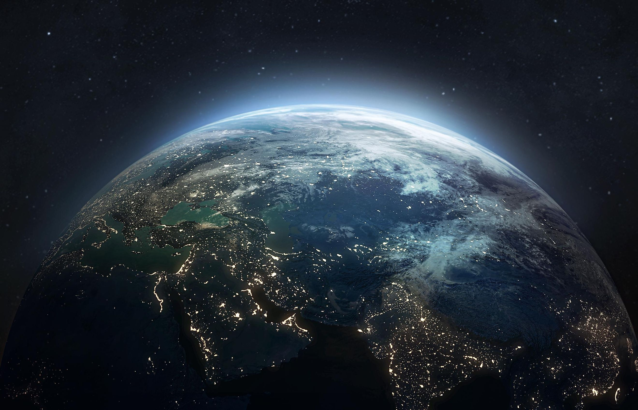

Slide 5
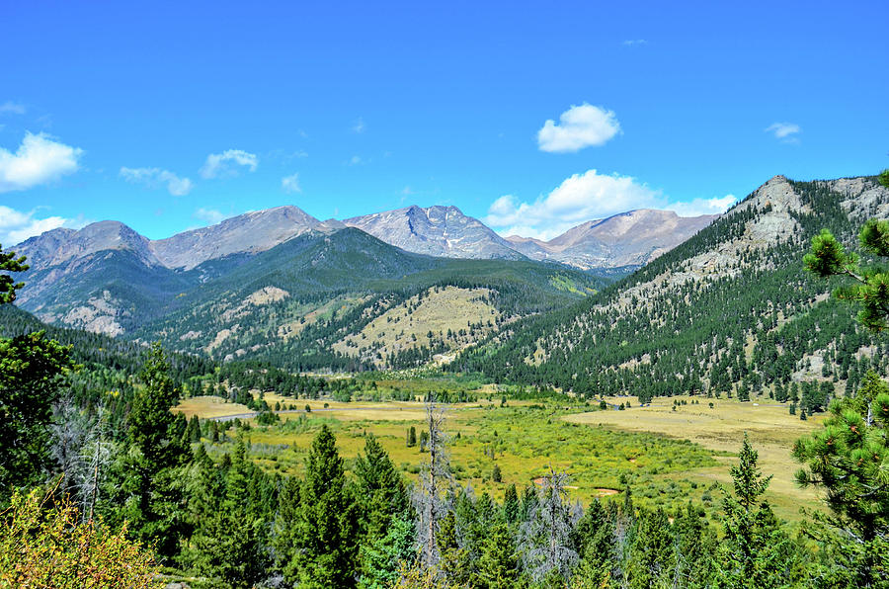

Slide 6
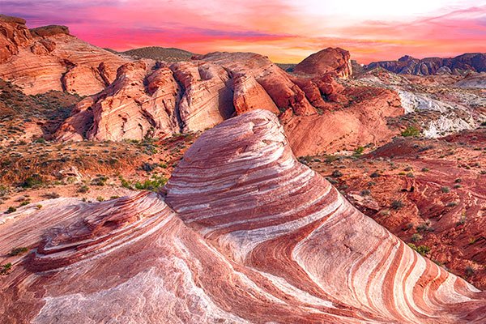

Slide 7


Slide 8


Slide 9
Let’s Praise Him
&
Give Thanks!

Slide 10
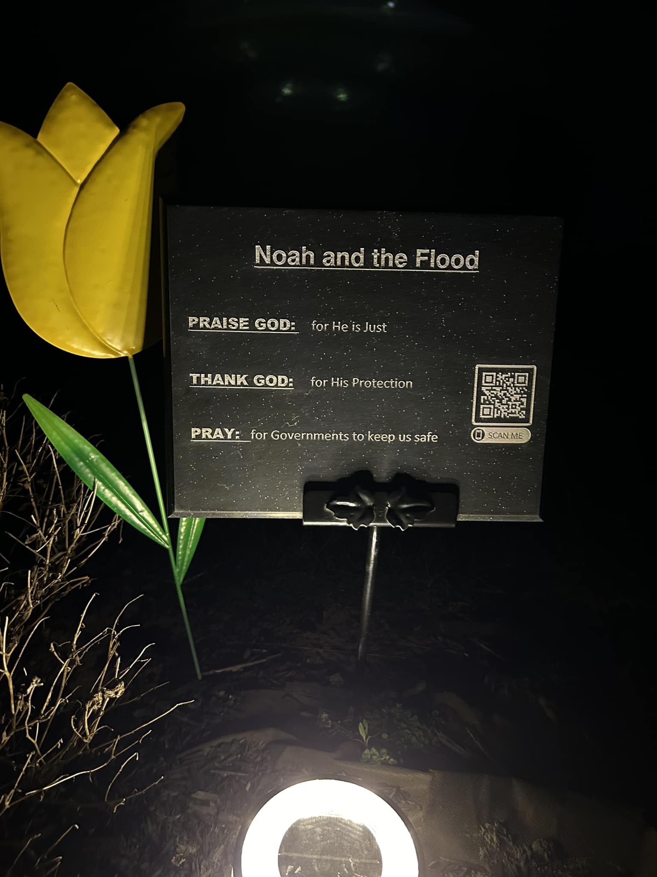

Slide 11
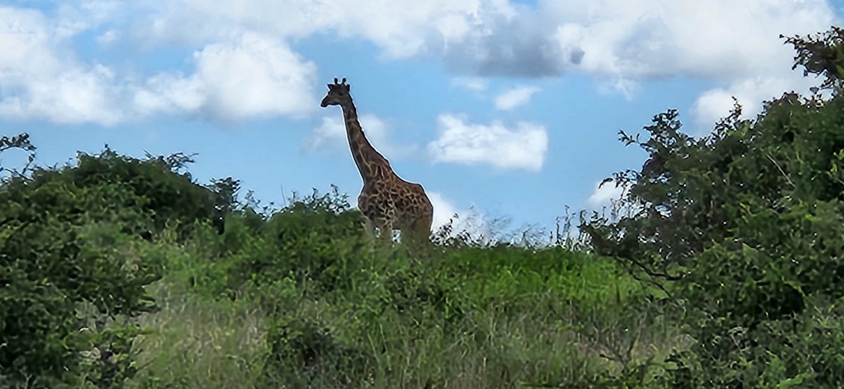

Slide 12
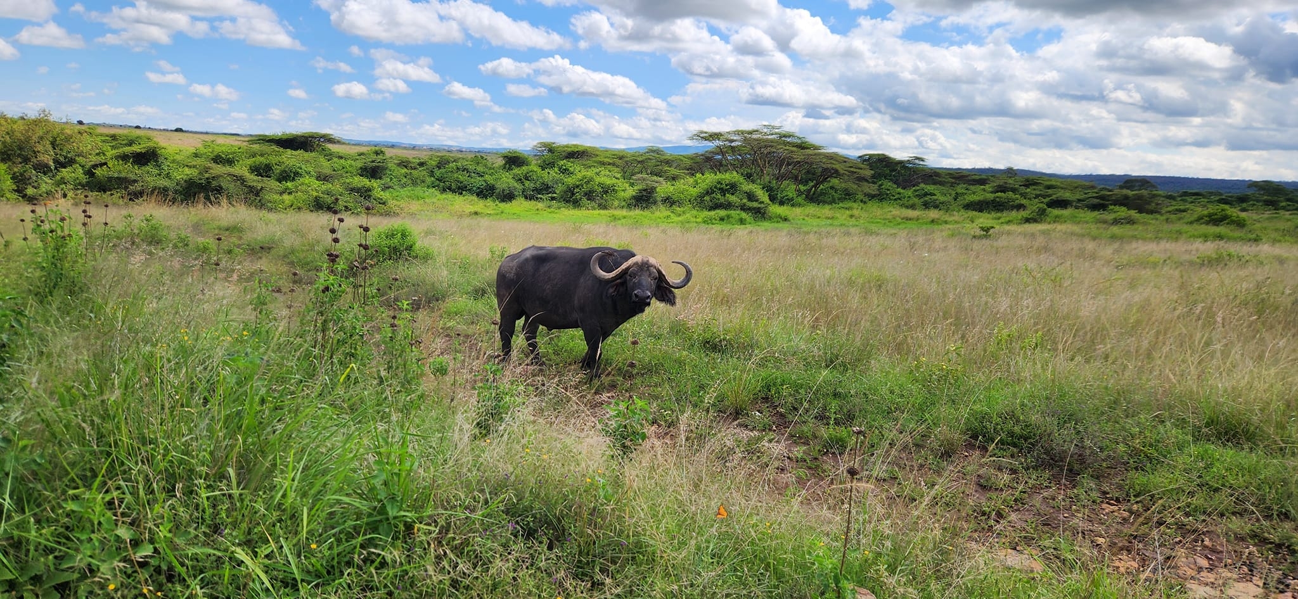

Slide 13
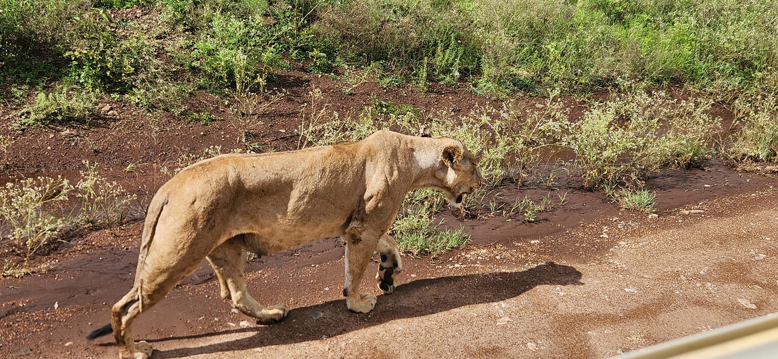

Slide 14
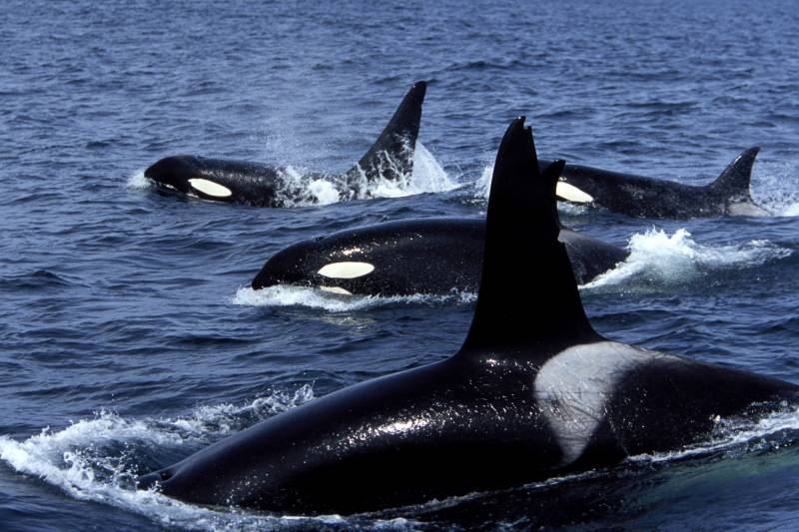

Slide 15
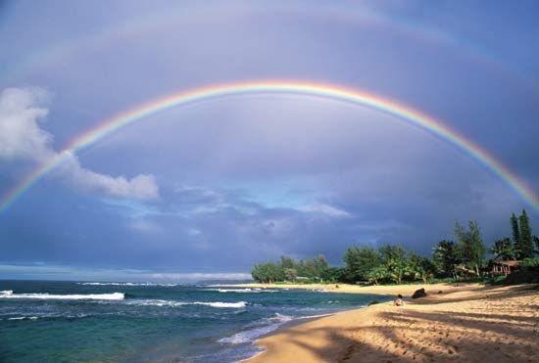

Slide 16
Let’s Praise Him
&
Give Thanks!

Slide 17
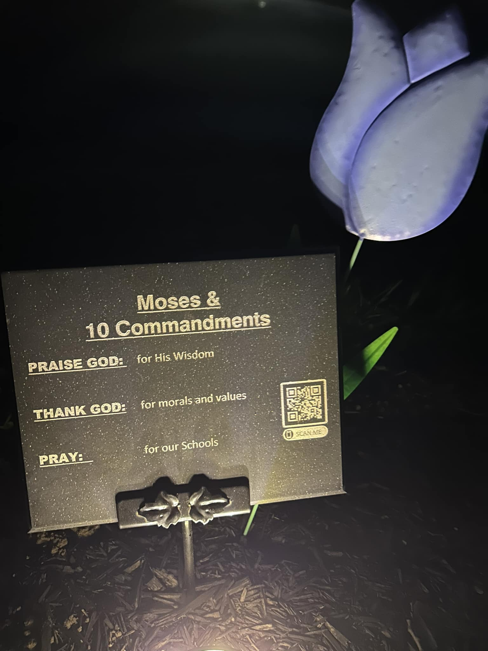
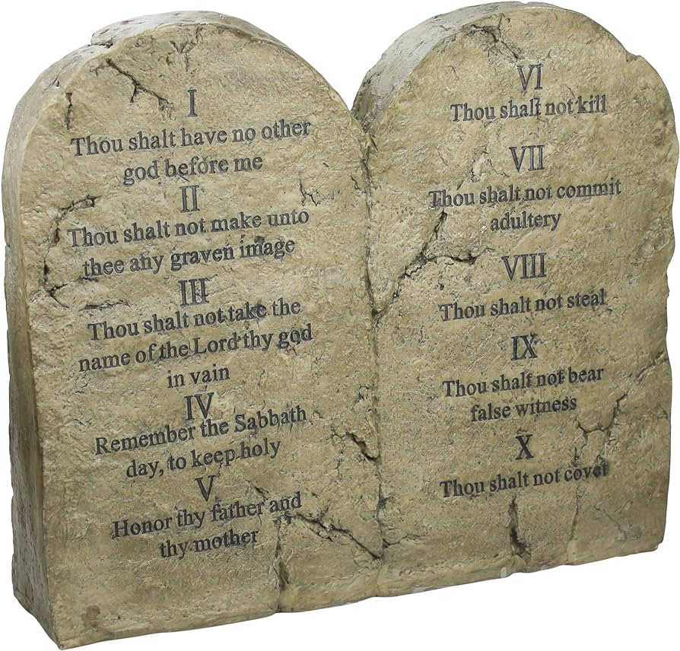

Slide 18
Let’s Praise Him
&
Give Thanks!

Slide 19
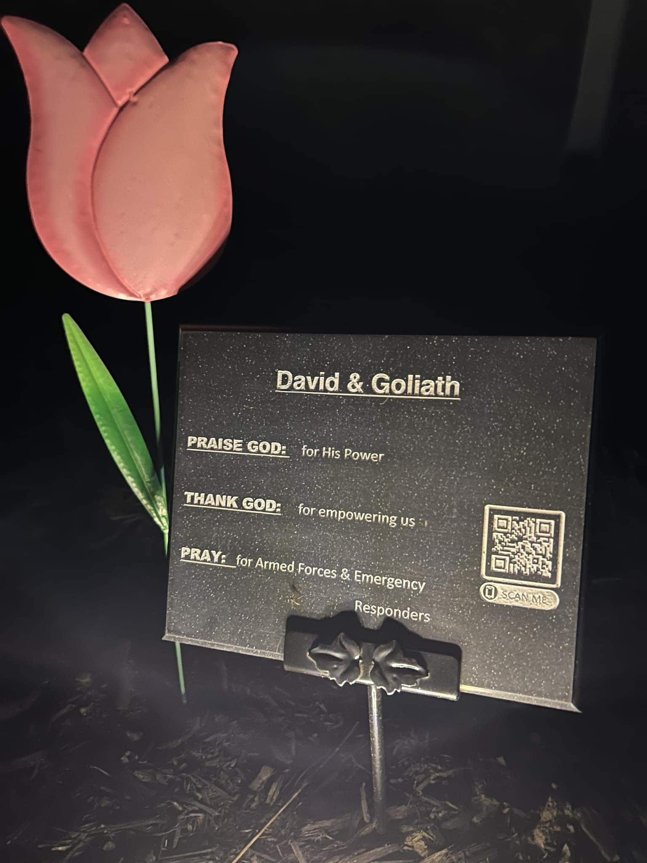
“The Lord is my rock, my fortress and my deliverer; my God is my rock in whom I take refuge, my shield and the horn of my salvation. He is my stronghold, my refuge and my savior-- from violent people you save me.
2 Samuel 22:2, 3

Slide 20
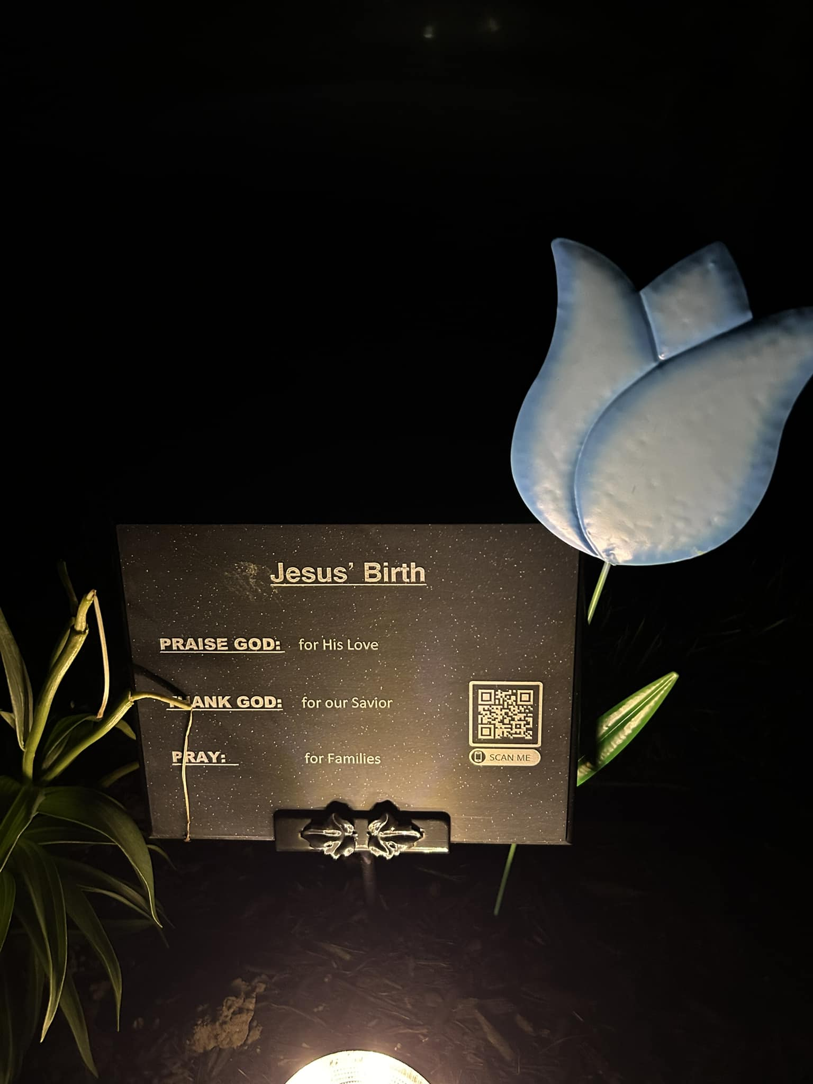
John 3:16, 17

Slide 21
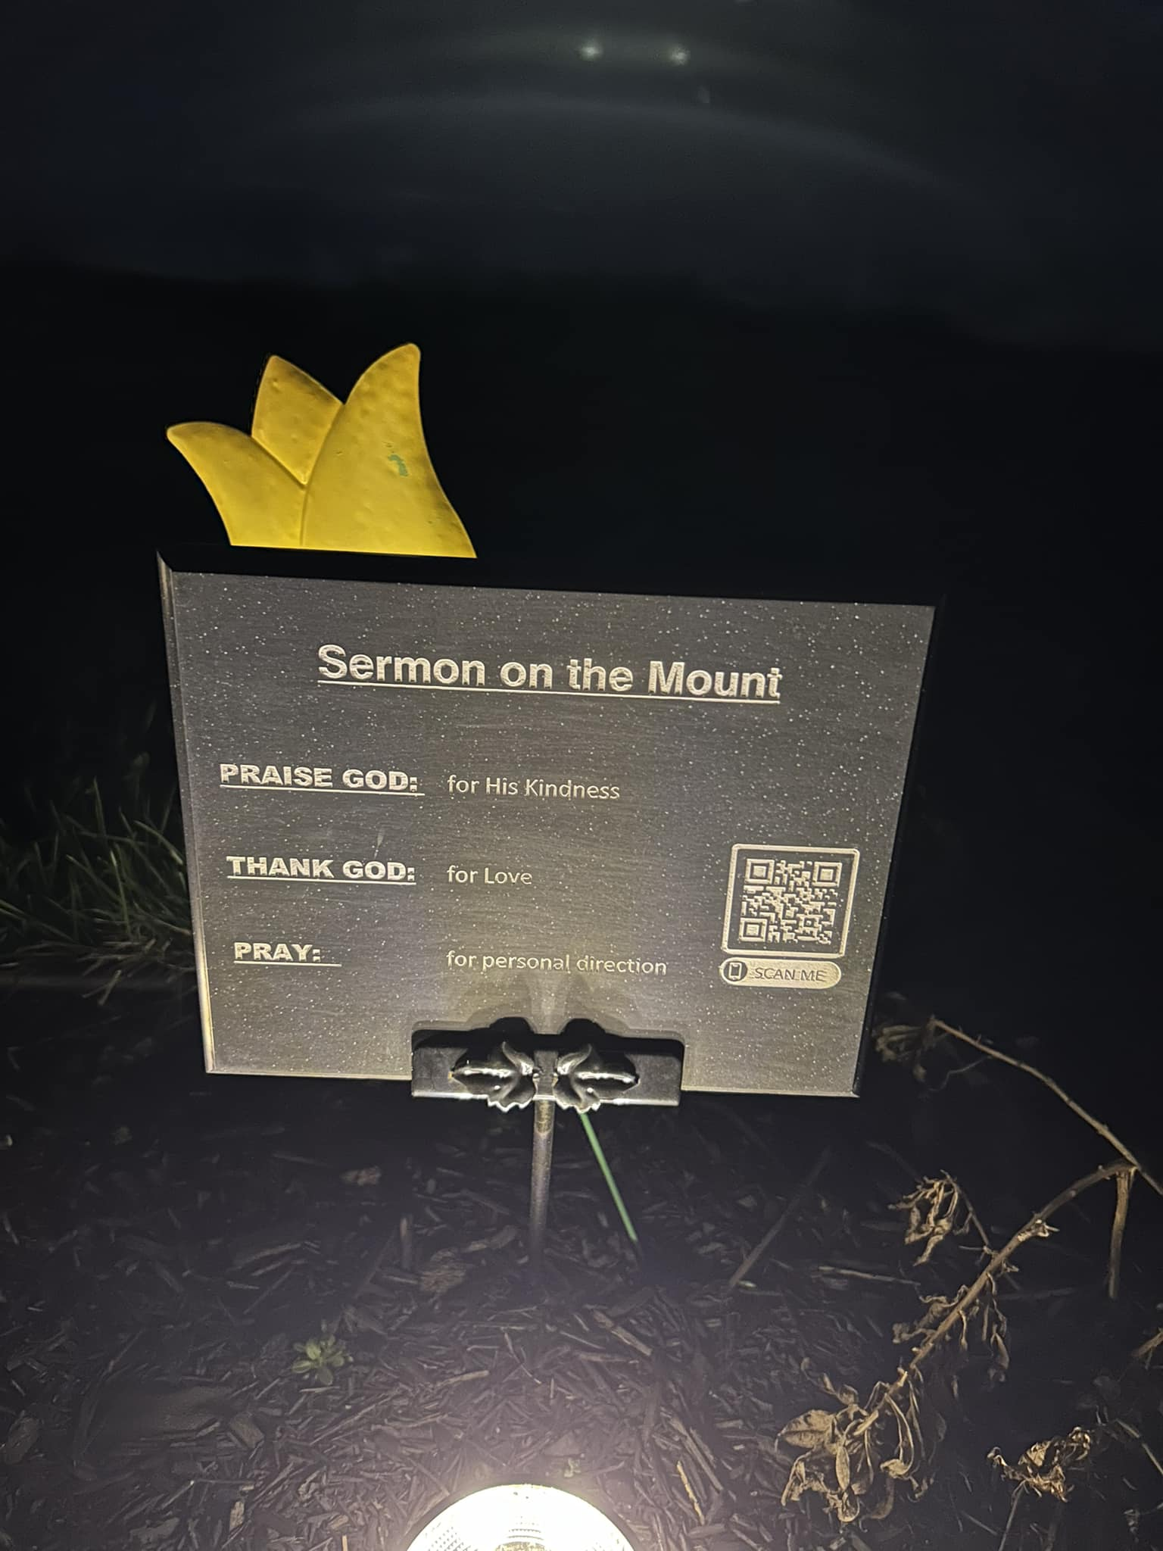
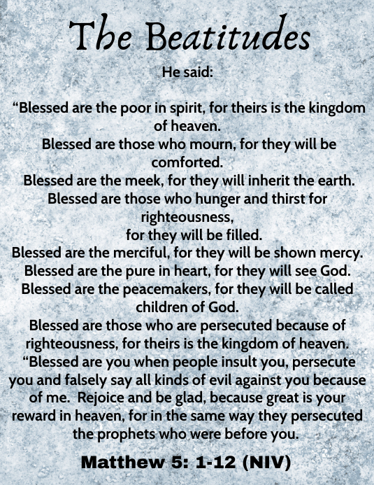

Slide 22
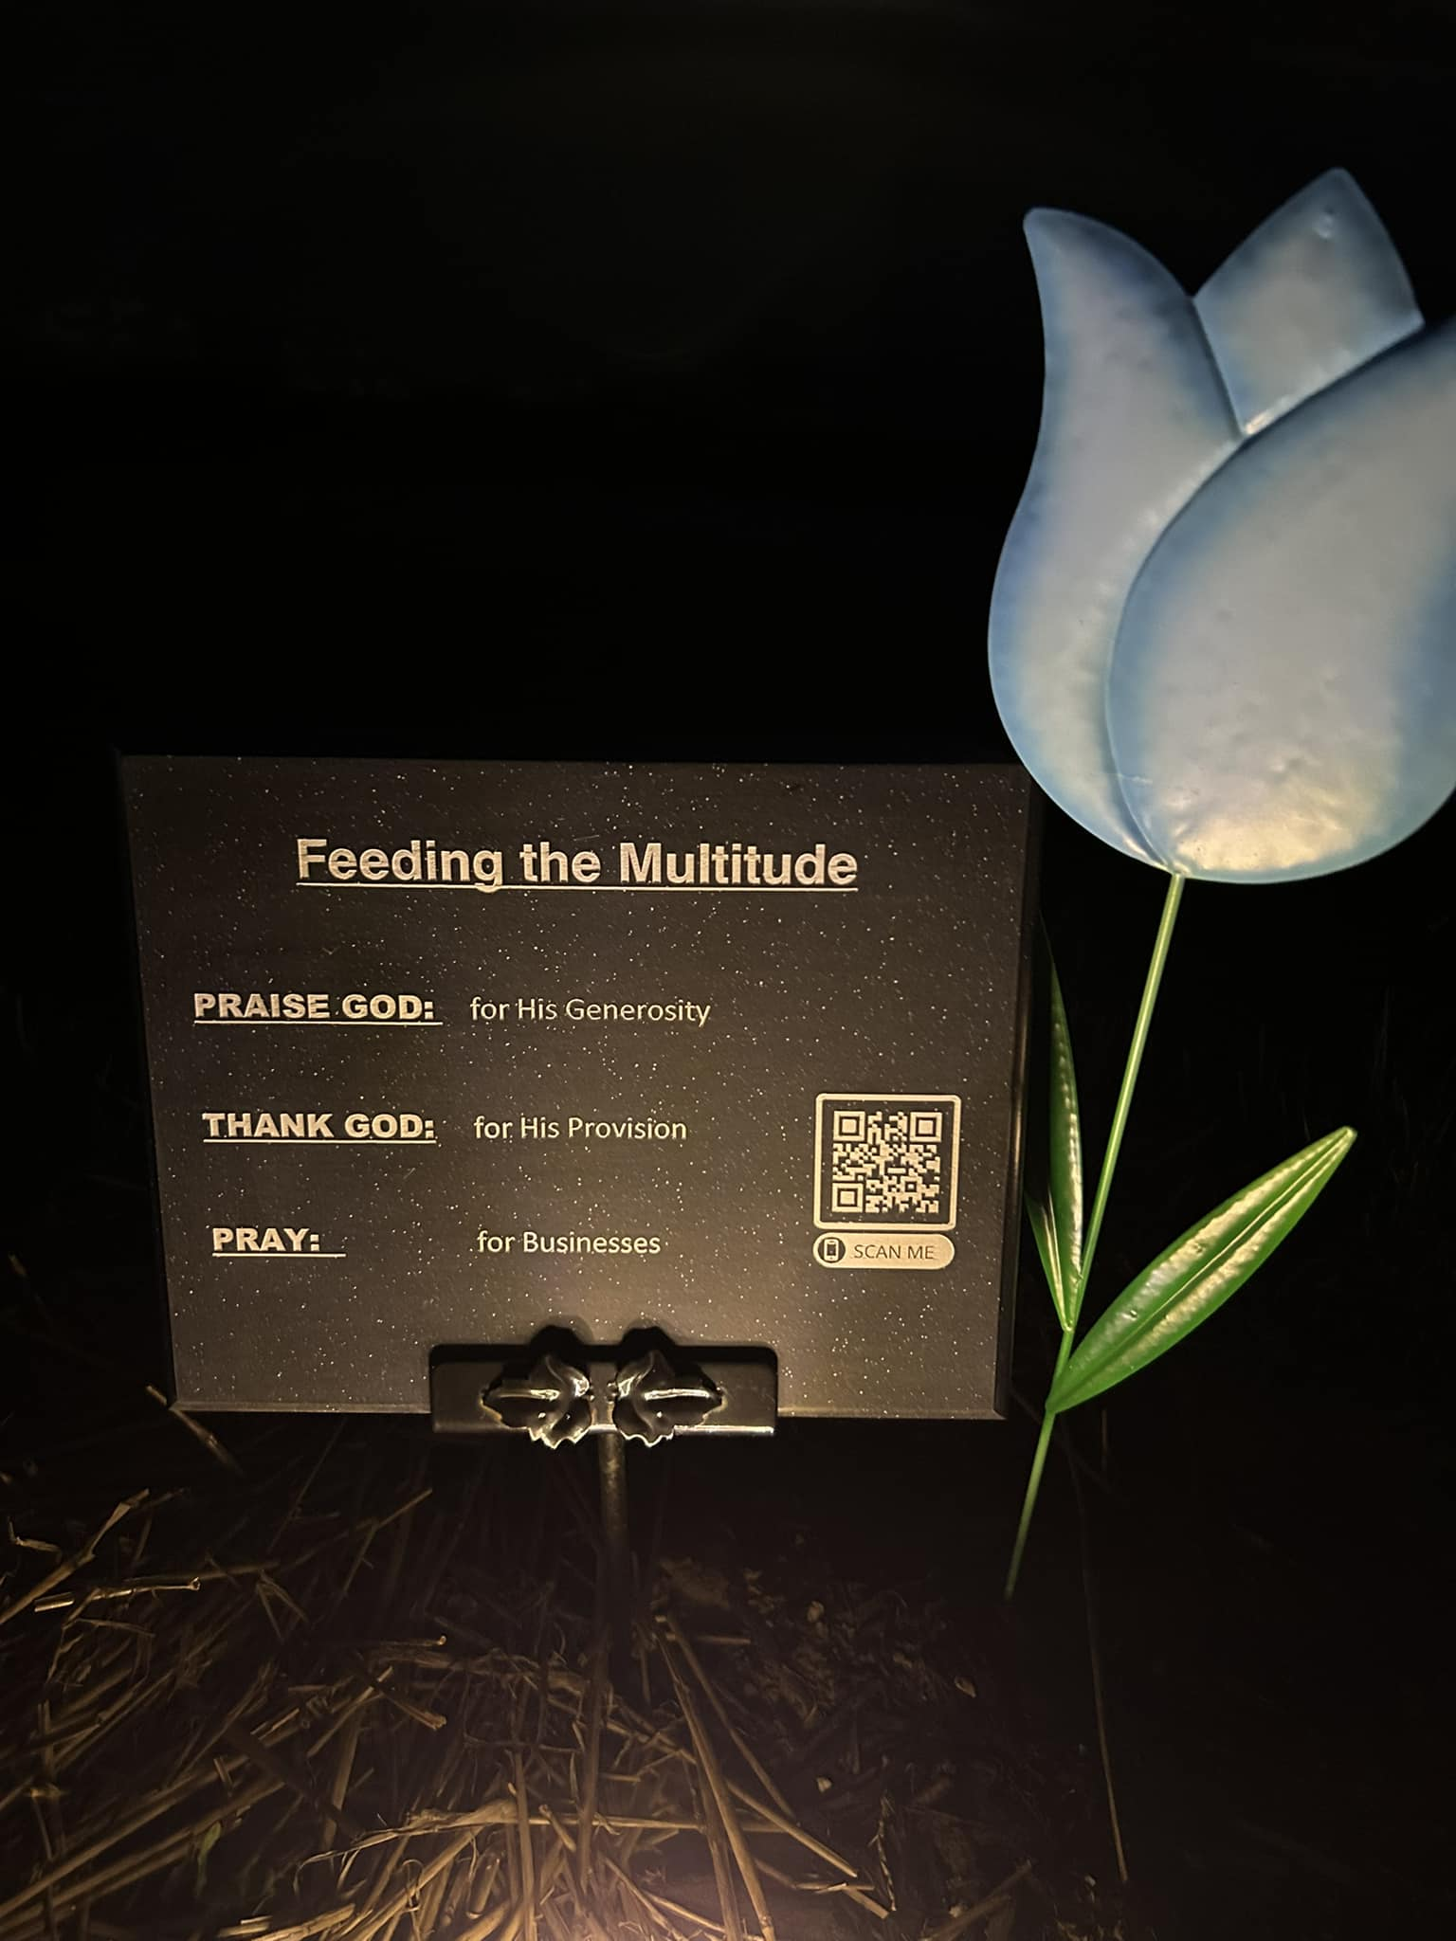
What God is doing in Clio to help those in need…

Slide 23
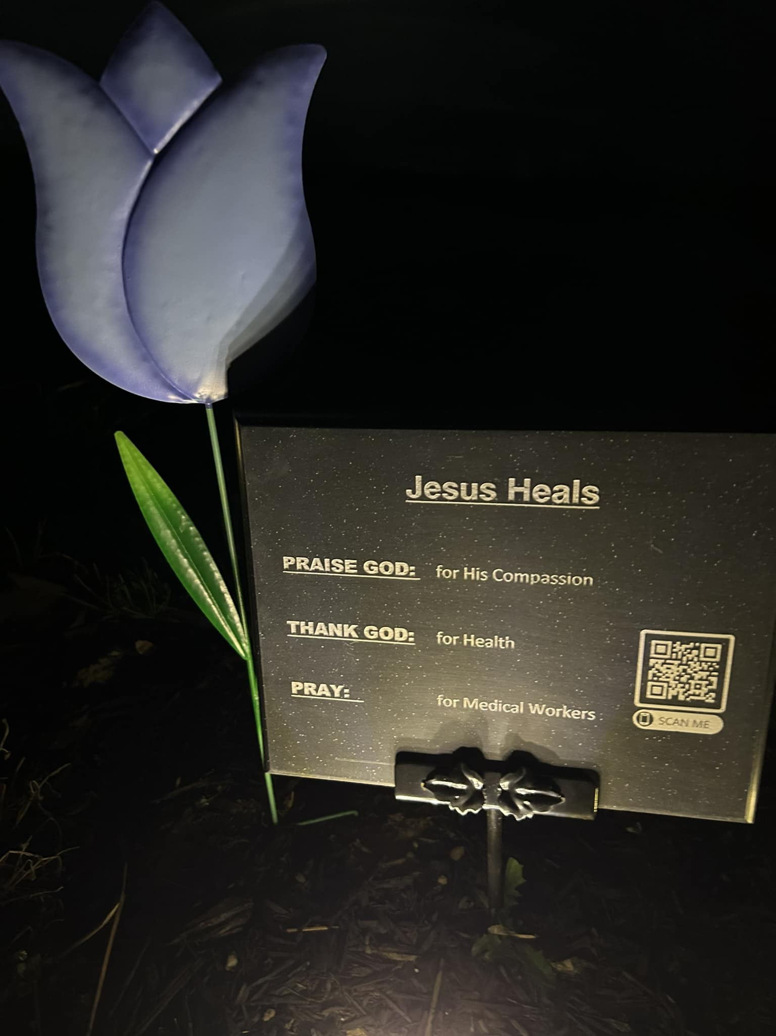
God’s power unleashed to transform lives!

Slide 24
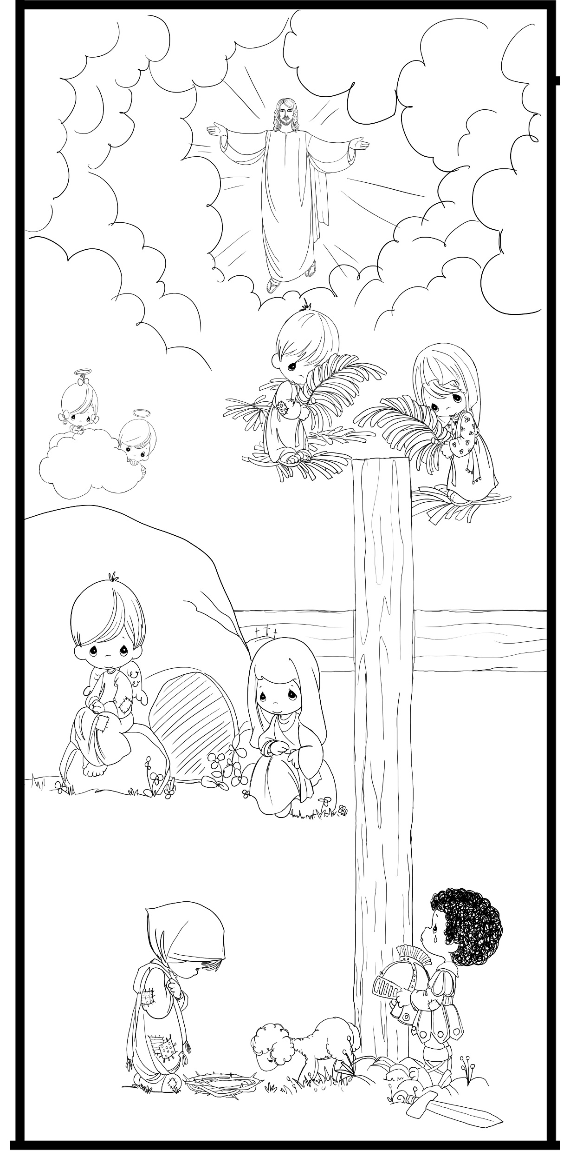
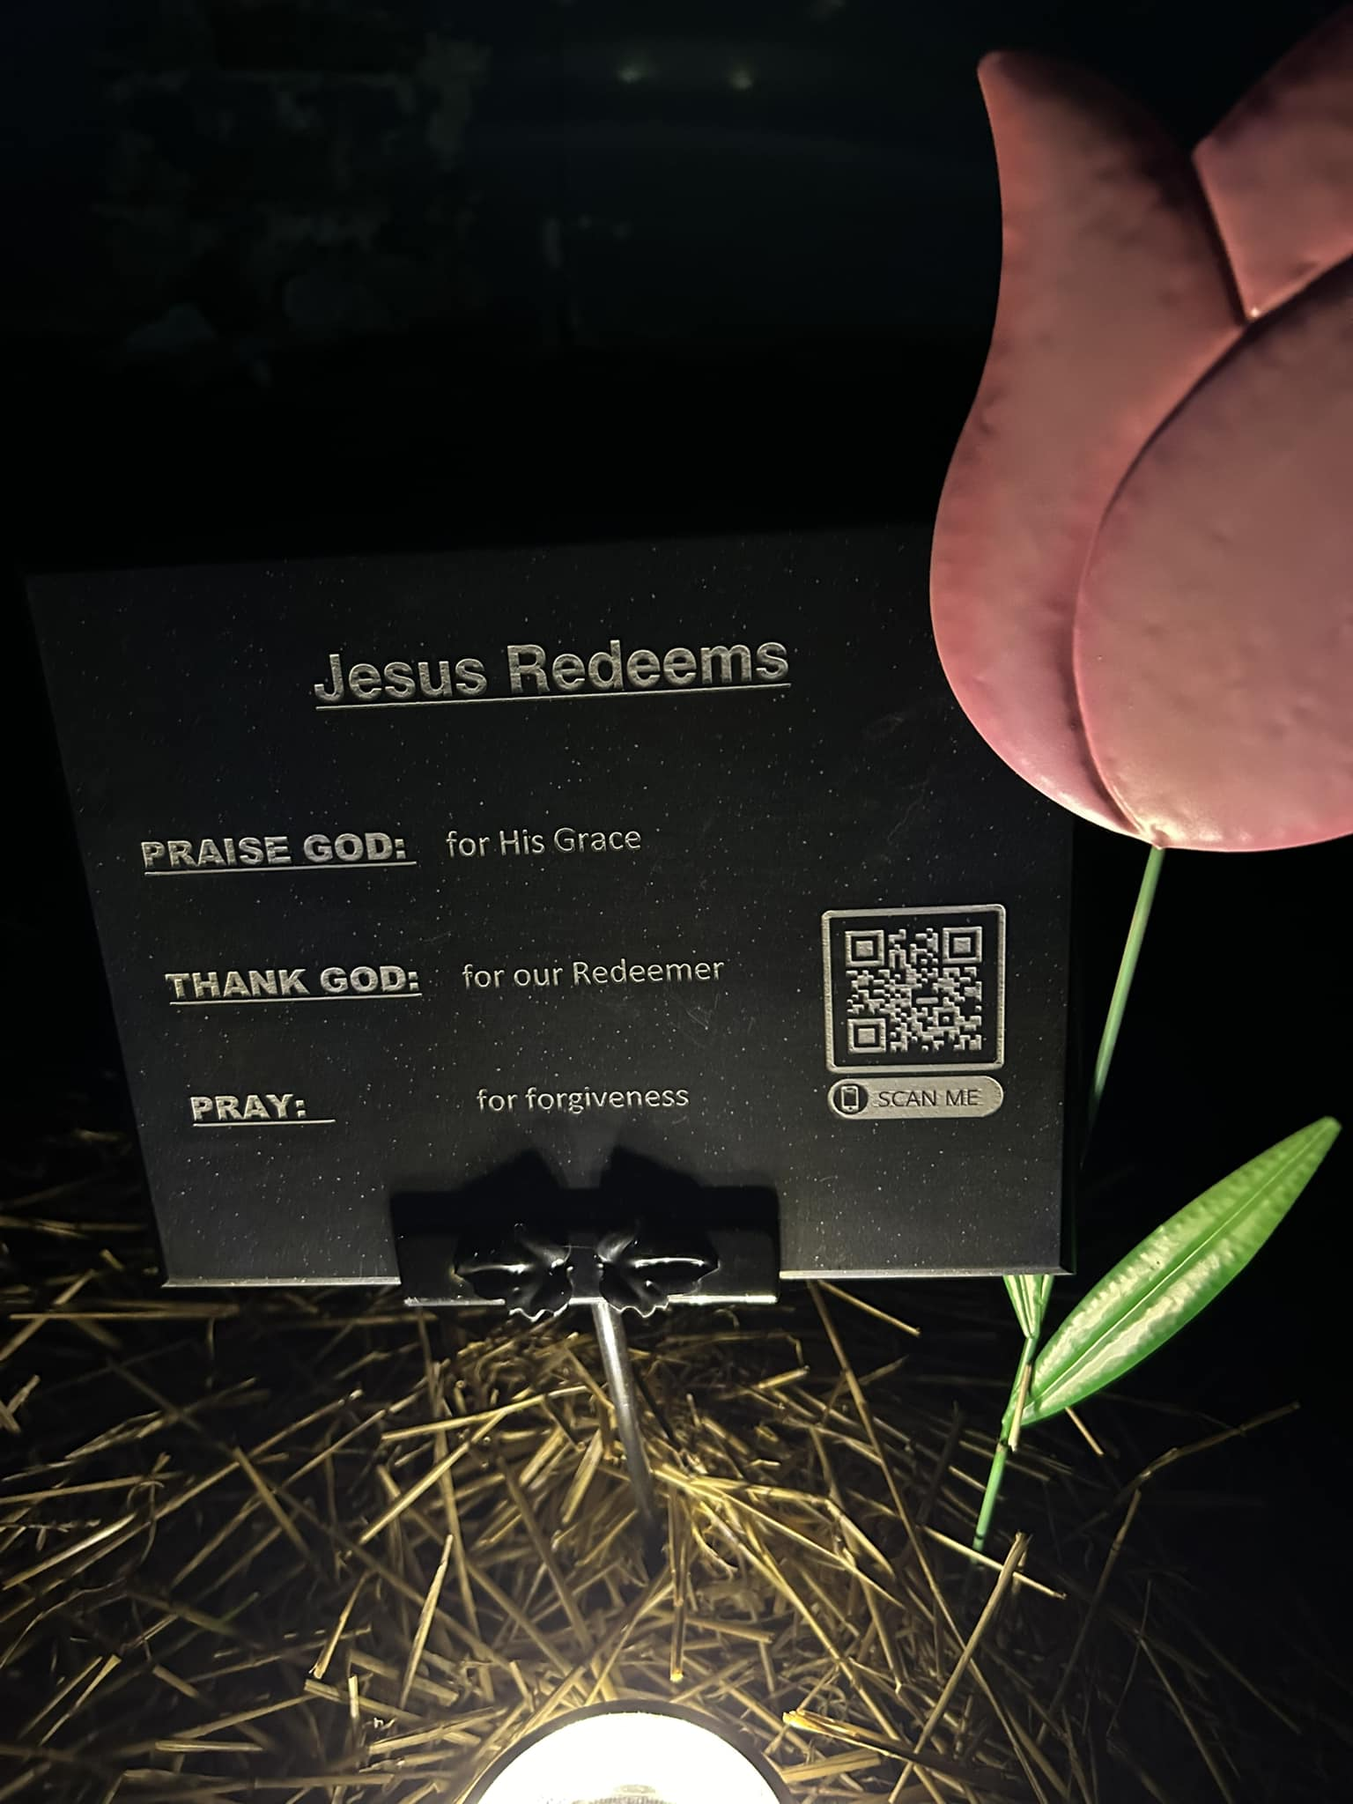

Slide 25
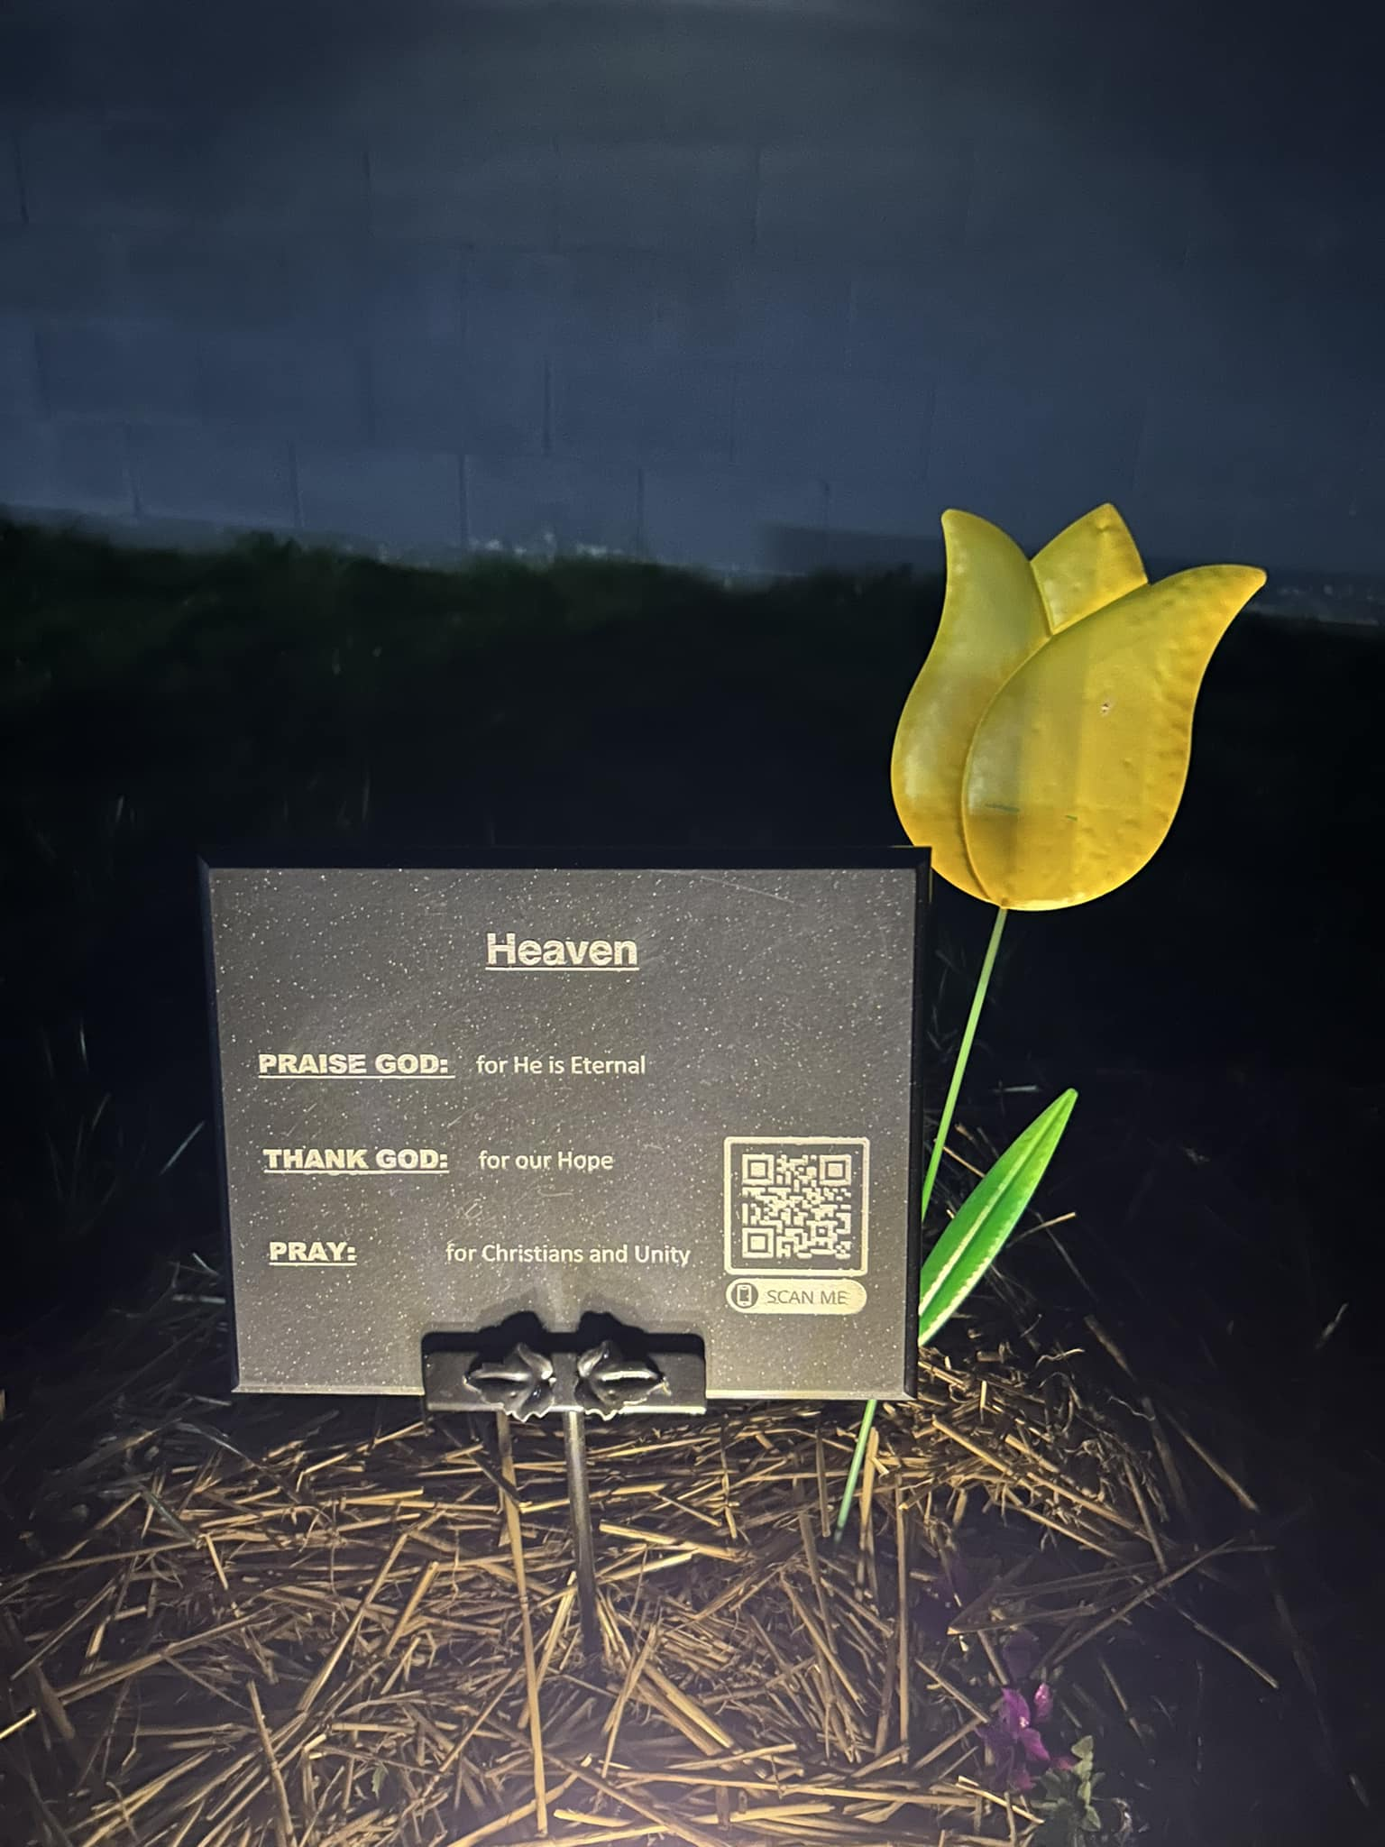
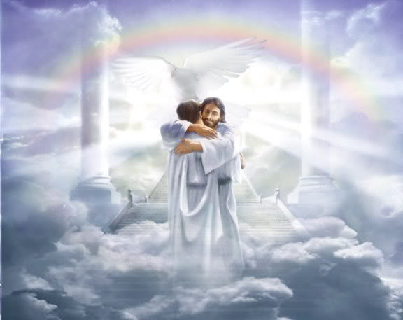

Slide 26
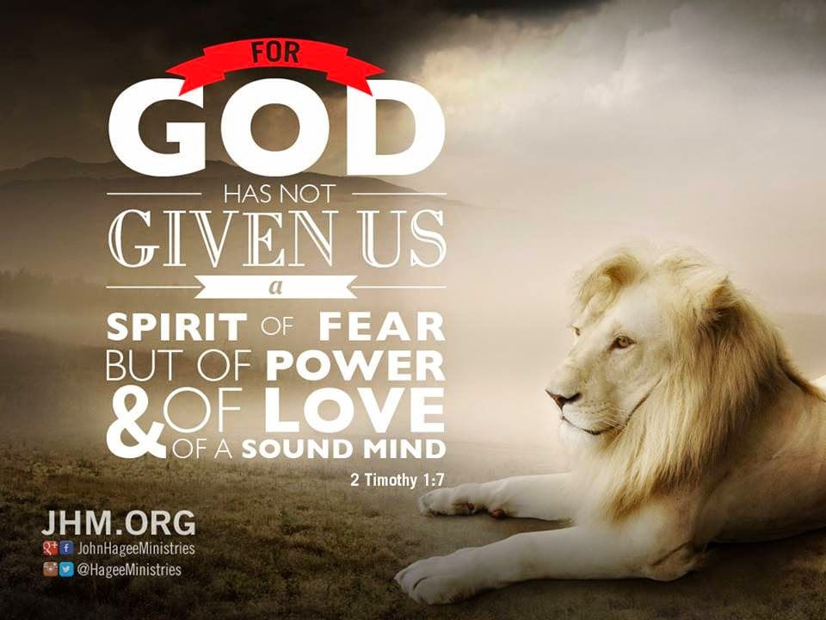

Slide 27
