Slide 1
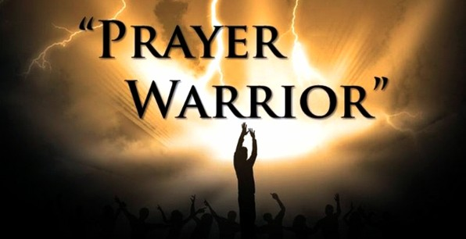
What God is doing!

Slide 2






TRANSFORMING CLIO

Slide 3

Gatherings…
4 Communities
  Clio
  Flint
  Frankenmuth
  Vassar
2 Others in Works
  Mt. Morris
  Birch Run
Others?

Slide 4
Uniting…
State Senator & Reps
County Commissioners
Township Officials
City Officials
Business Leaders
2 Counties
6 Communities

Slide 5
Working Together
Planning
Recruiting
Promoting

Slide 6
Helping
Businesses
Organizations
People

Slide 7
Christians Leading
Worship & Prayer
Meeting Needs
Working & Serving
Setting Example in Unity & Love

Slide 8
Keep Praying…
GOD is Hearing
GOD is Acting
GOD is Recruiting
GOD is Uniting
GOD is Placing Pieces
GOD is identifying needs and opportunities!

