Slide 1
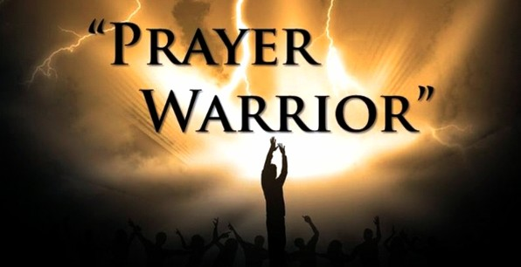
What God is doing!

Slide 2






TRANSFORMING CLIO

Slide 3
On March 6…
Started Recruiting
  5 Communities
  1 congregation

Slide 4
March 9
14 Communities
4 Local Congregations

Slide 5

March 10
16 Communities
5 Congregations
Contacted 50+ People in Saginaw and Genesee Counties
Met with 15 community leaders from around state (Upper Peninsula, Northern Michigan, down to Macomb County

Slide 6
March 11
Preachers from across Mid-Michigan gathered in Grand Rapids and challenged to recruit Prayer Warriors in their communities

Slide 7

March 14…
Called for us to recruit Business & Government leaders from
  Saginaw
  Bridgeport
  Birch Run
  Clio
  Mt. Morris
  Flint
Form Committee to work on “Ojibway Trail” Designation for M-54 (starting at I-69) to Dixie Highway (ending at M-46)
Create relationships

Slide 8
March 16
16 Communities
6 Churches
Task to create: National Day of Prayer in those communities (ASAP)
Task to create committee of Business & Government leaders from 7 cities/2 Counties by April 14
Challenge Spreading throughout the State

Slide 9
Keep Praying…
GOD is Hearing
GOD is Acting
GOD is Recruiting
GOD is Uniting
GOD is Placing Pieces

