Slide 1
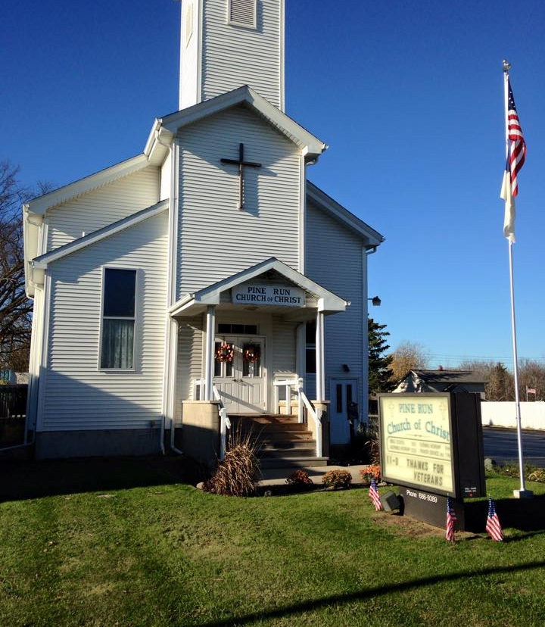
Annual Report
2024
A brief look back…
as we move forward….

Slide 2

Loving God-- Worship
Weekly Services
  Praise
  Prayer
  Communion
  Message

Slide 3
Loving God-- Worship
Special Services
  Father’s Day
  July 4th
  International Day of Prayer for Persecuted Church
  Veterans
  Schools
  Thanksgiving
  Christmas
  Valentine’s
  Palm Sunday
  Easter
  Church Birthday
  Mothers Day
  Memorial Day
Daily Living

Slide 4

Loving God-- Bible Study
Daily Bible Reading Plan & Devotions
Bible School
Midweek Study available
Online Studies at website
  20 Online Studies
    cover Genesis-Revelation
    Topical for Daily Living
    Science Interest
  32 Children Old Testament Studies
  10 New Testament Puppet Shows

Slide 5

Loving God-- Prayer
Weekly Prayer Lists
Daily Prayer Emphasis (found on Calendar)
International Day of Prayer for Persecuted Church
  1st Sunday in Nov
National Day of Prayer
  7 AM Meeting Here for Leaders
  Noon Meeting for Community

Slide 6
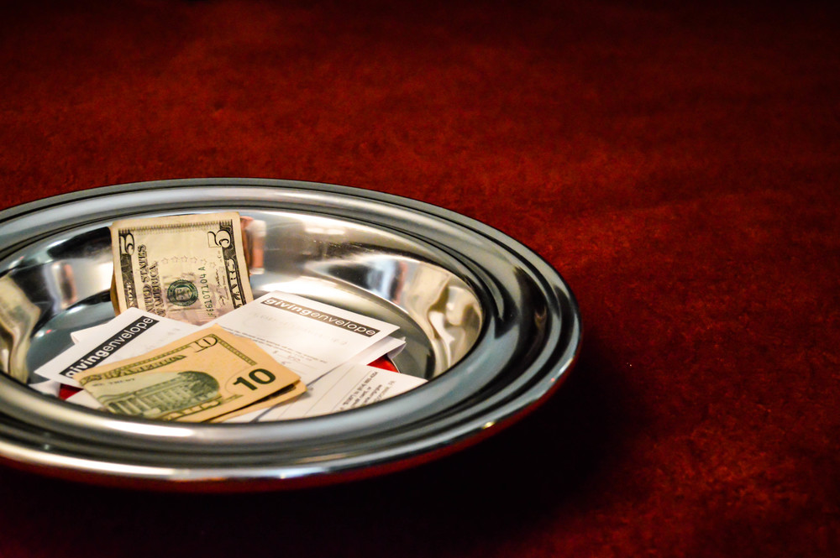
Loving God: Giving
Congregational Giving is increasing
Giving by Individuals outside of congregation Increasing
  One time Gifts
  Quarterly Support
  Monthly Support
Community Support (Grants & Gifts)
  Paid for removal of Trees
  Help pay for new Sign Panels

Slide 7

Loving Others-- Outreach
Food Trucks
“Scarecrow Invasion”
Candlelight Nite
“Scenes of The Season”
Palm Sunday
Easter
“Hometown Heroes”
Newspaper Ads
Social Media

Slide 8

Loving Others-- Support
Schools
  “Back to School” Night
  Food Backpack Program
  Prayers and encouragement
  Education Week Emphasis
  Promotion of Accomplishments
  Advice and Opportunity

Slide 9

Loving Others: Support
Businesses
  Chamber of Commerce
  Food Trucks
  Alkay Fly-In/Walk-In
  Promotion on Social Media
  Supporting Local Businesses
  Decorating Contests
  Upcoming: “Clio Summer Kick-Off”

Slide 10





Loving Others: Support
Community Leaders
  Common Ground
  Clio 150th Anniversary Celebration
  Clio Memorial Day Run
  Advisor to:
    Clio Mayor
    Vienna Township
    Vienna Township BDA
    Clio Human Services Fund
    Amphitheater
    Clio Community Council
    Clio Firefighters
      Clio Summer Kick-Off
    Rotary and Clio Cares

Slide 11

Loving Others: Support
Uniting Believers
  Vacation Bible School Promotion
  Church School Supply Distribution @ Back to School Night
  Involvement in Food Distribution
  Coordinating involvement in Clio Candlelight Night
  Coordinating National Day of Prayer
  Coordinating Christian Concerts

Slide 12
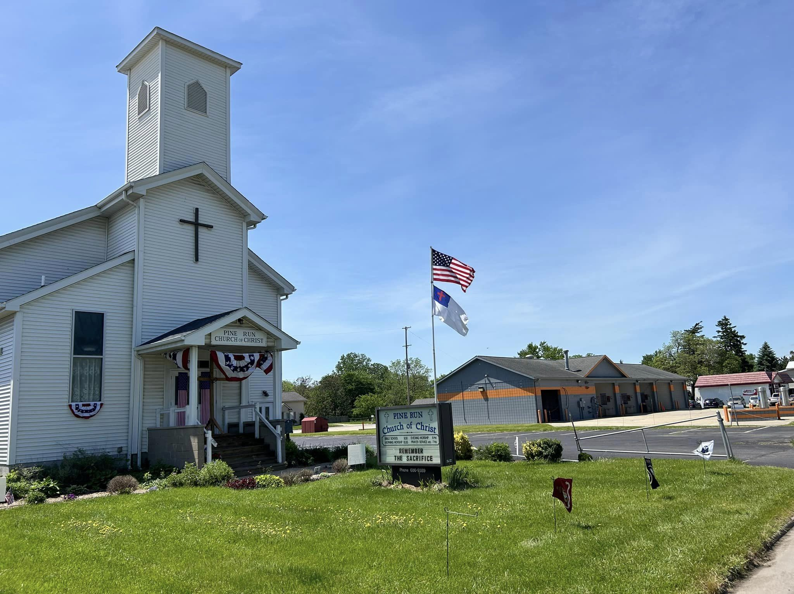
Loving Others: Support
Our Members
  Prayers
  Teaching
  Encouragement
  Support

Slide 13
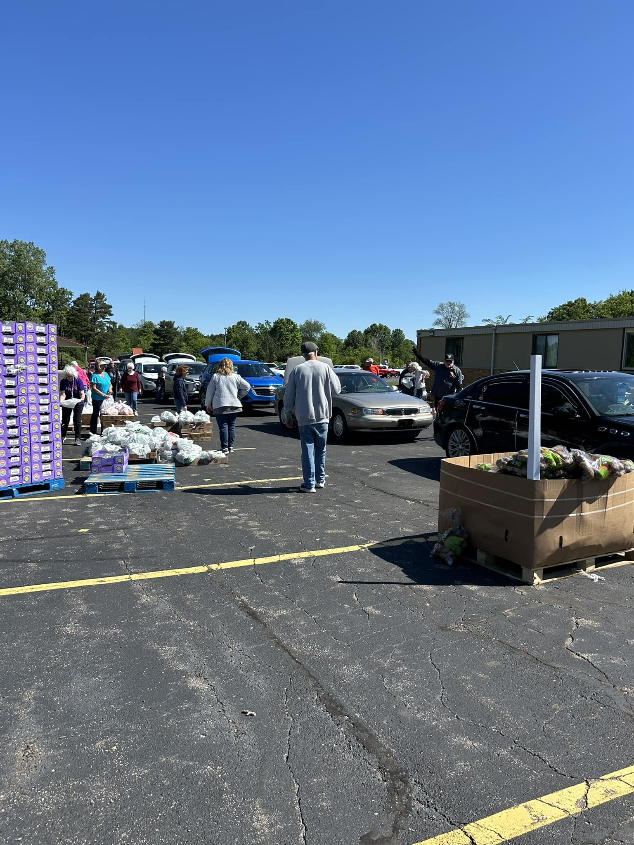
Loving Others: Support
Benevolence
  Food Backpack program in Schools
  Community Food Distribution Coordination
  Expansion of Clio Human Services Fund
    Dental Care
    Health Coverage
    Classes to help people improve quality of life
    * Utilities/Rent Assistance

Slide 14

Loving Others: Missions
Financial Support
  Clio Human Services Fund
  Wolverine Christian Service Camp
  Rock Lake Christian Assembly
  Michigan Christian Campus Ministries
  Great Lakes Christian College
  “Operation: ‘We Care’”
  A Christian Ministry to the National Parks
  Mexican Christian Mission
  H.O.P.E.
  Bibles to Russia

Slide 15
Loving Others: Missions
Daily Contact
  Workers in 29 Countries
    North America
    South America
    Europe
    Africa
    Asia
    Australia
    Pacific Region
  Devotions & Prayer

Slide 16
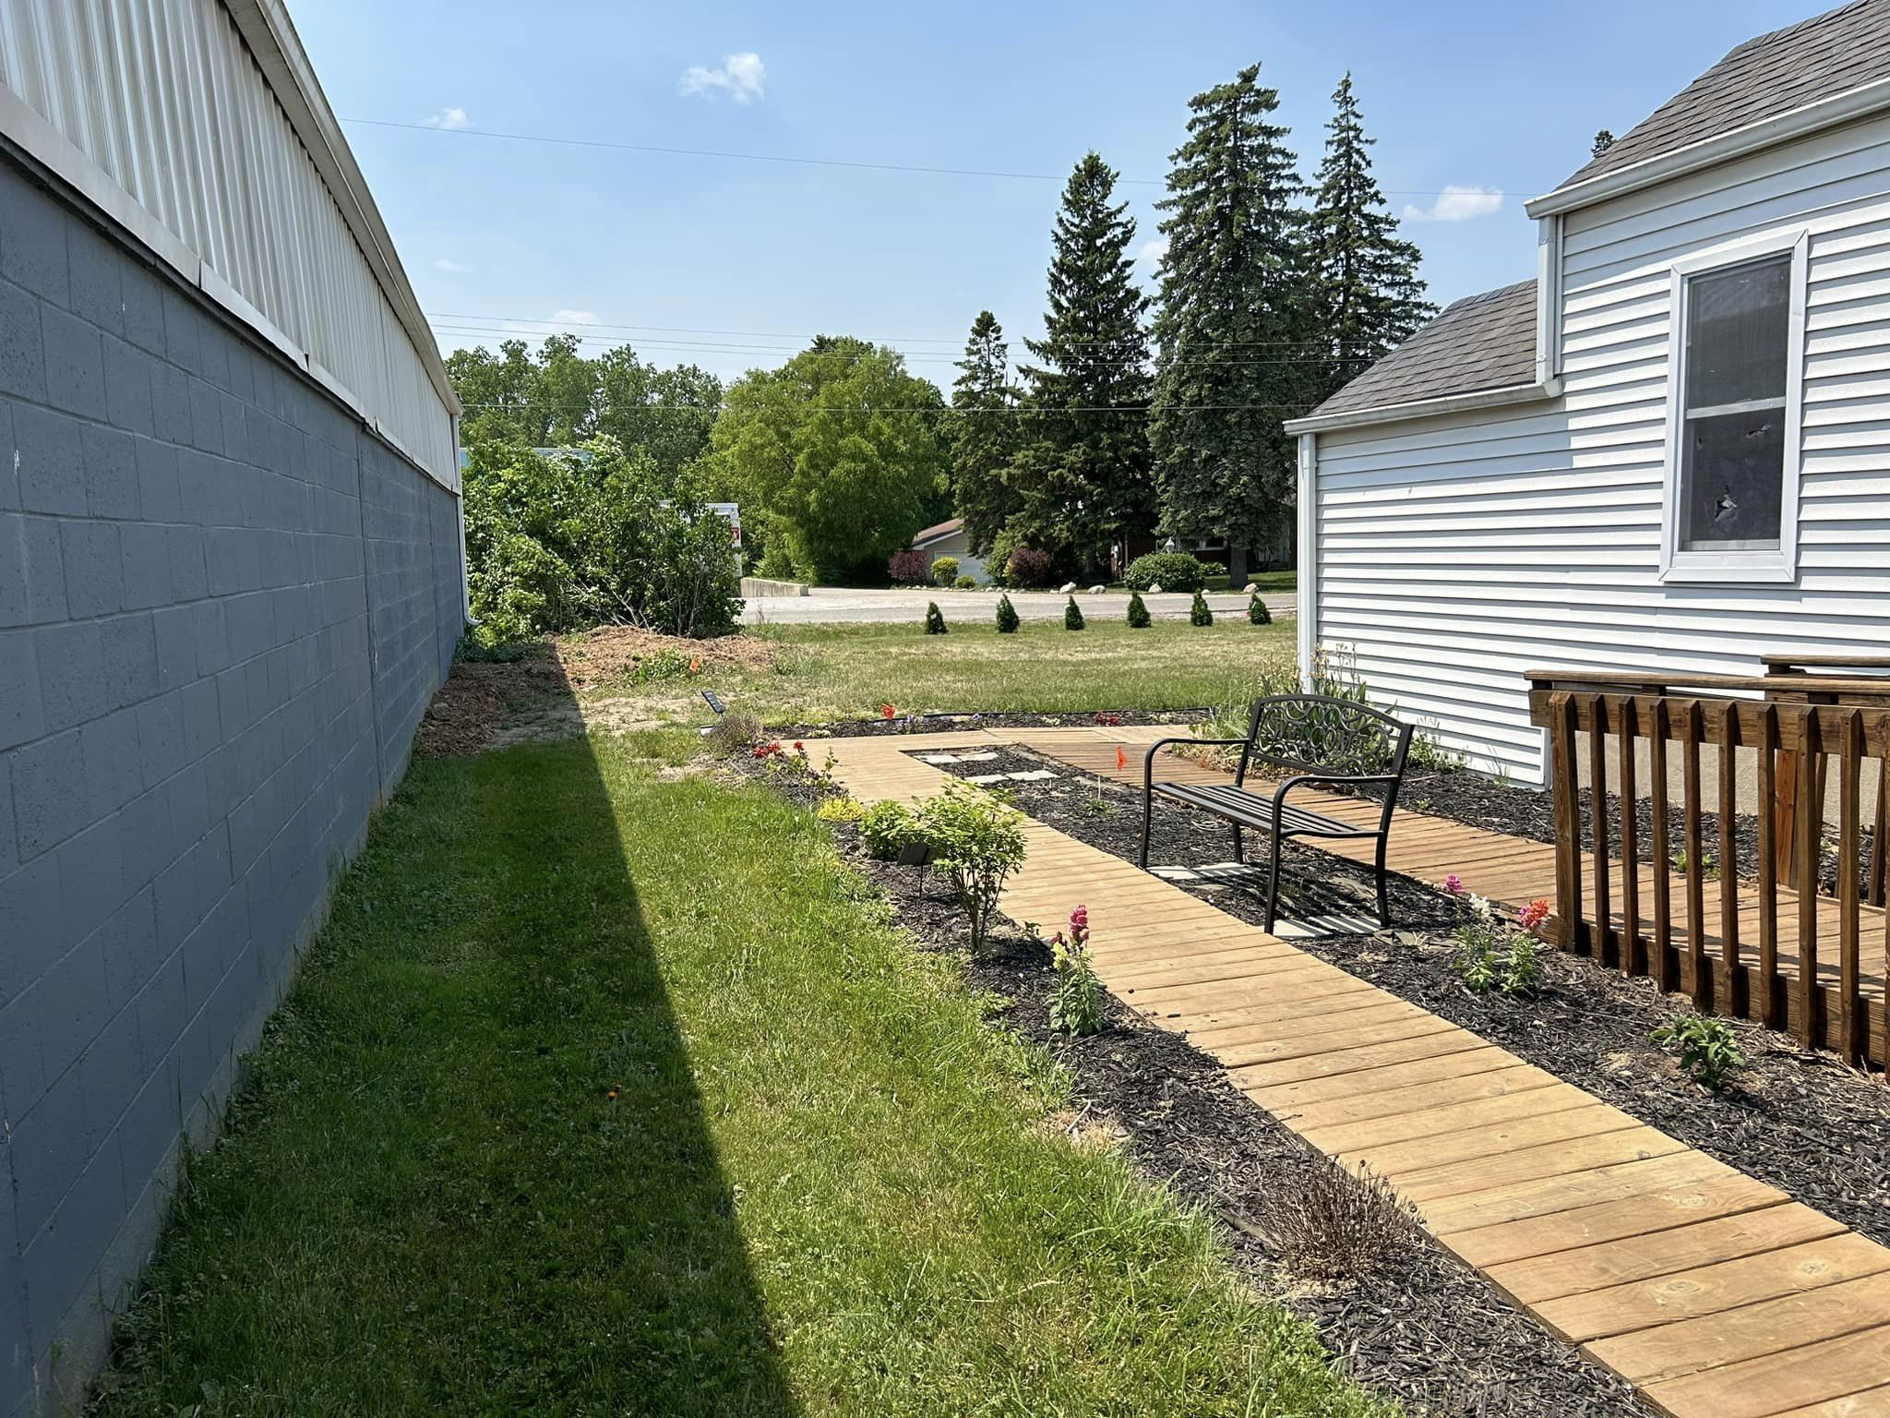
Loving Others: Prayer Walk Park
Development
  Trees Removed
  6 trees planted
  More perennial plants
  Staining/Sealing ramp & boardwalk
  Decorations for different seasons/months
  Bird Feeders
  Plantings in Memory
    Rhubarb-- John Dougherty
    Gladiolas-- Gladys Carlson
Usage
  Featured in National Day of Prayer Program
  Featured in Social Media Posts
  Site of upcoming “Summer Christian Concerts)
  Available for daily use

Slide 17

Following God-- Wherever He Leads…

