Slide 1
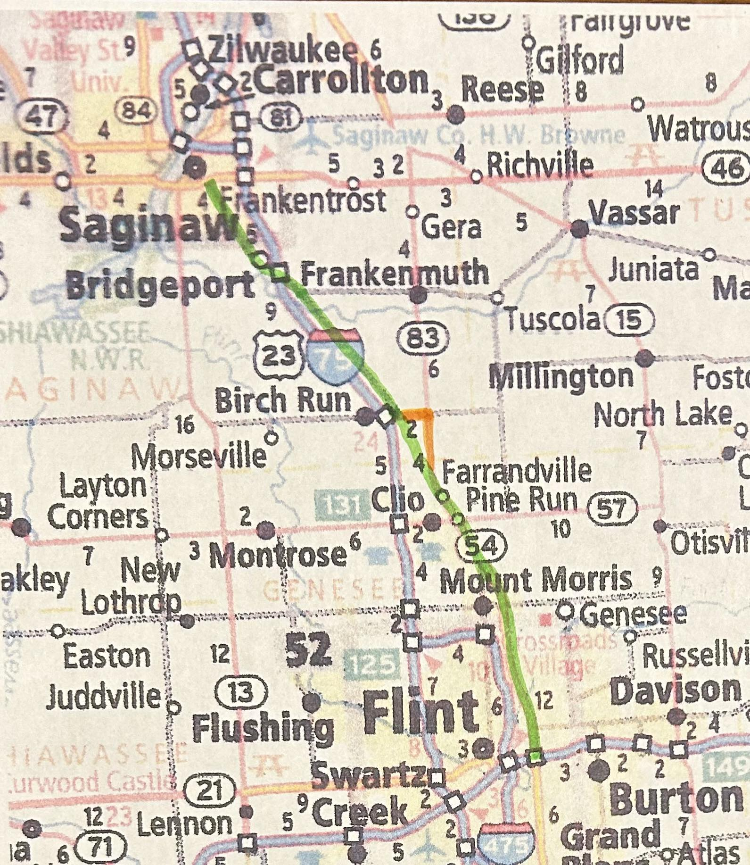

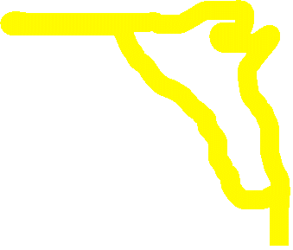


Welcome:
“Michigan Living”

Slide 2

TO Create, a corridor connecting Flint and Saginaw that provides livelihood, along with balance of recreation and personal growth.

Slide 3

THE “Michigan Living” coalition will establish & promote (including education), preserve and protect the multiple recreational, cultural, natural, and historical attractions of the trail through collaboration of: government entities including cities, townships and counties, along with Chambers of
Commerce, Business/Downtown Development associations, interested groups, Michigan Department of Transportation and citizens from Flint to Saginaw.

Slide 4

Route Defined
Route Narratives
Route Inventory
Top 15 Attractions

Slide 5

GOALS
1 Route Determined and affected communities connected by 10/25
2 Complete Descriptions of the Route by mile and then compile by 10/25
3 Build listing of Recreational, cultural, historical and scenic attractions within 5 miles of the Route by 10/25
4 Select the “TOP 15 Attractions” by 9/25
5 Determine “weaknesses” along route and plan to address by 10/25
6 Promote the Route plan established by 11/25
7 Protect the Route plan by 11/25
8 Set up “Continuation Program” for the Route by 11/25
9 Submit proposal to MDOT/PMB for acceptance by1/26

Slide 6


Route Determined and affected communities connected by 10/25
Route determined by 6/25
Connect with affected communities by 9/25

Slide 7
Descriptions of the Route by mile and then compile by 10/25
Break Route into Sections by 6/25
Sections assigned and to be completed by 9/25

Slide 8
Build listing of Recreational, cultural, historical and scenic attractions within 5 miles of the Route by 10/25
List Recreational attractions along the route by 9/25
List Cultural, Historic and Scenic attractions along the route by 9/25
List Recreational attractions within 5 miles of route by 9/25
List Cultural, Historical and Scenic attractions within 5 miles of route by 9/25

Slide 9
Select the “TOP 15 Attractions” by 9/25
Establish “working list of “Top 15” by 6/25
Saginaw: Old Town, Shiawassee Nature Preserve, Castle Museum, The Village
Frankenmuth
Bridgeport Historical Society
Birch Run: Birch Run Speedway, Wilderness Trails Zoo, Outlet Shopping
Clio: Auto City Speedway, Vienna/Clio Park & Cultural Corridor
Flint: Crossroads Village & Huckleberry Railroad, Children’s Museum, For Mar Nature Preserve, Riverside Parks (Besides Cultural Center!)
Solidify “Top 15” by 10/25

Slide 10
Determine “weaknesses” along route and plan to address by 10/25
Identify “blighted” areas and work with community and local groups to create plan to address 10/25
Identify needed “signage” by 10/25
  Identification of Route
  Identification/Directional for Attractions
Identify areas that need help promoting by 10/25

Slide 11
Promote the Route plan established by 11/25
Identify “Promotions” already in place 10/25
Identify areas needing help in promotion by 10/25
Recommendation for promotion to MDOT/PMB 11/25
Plans for “additional” promotion by 11/25

Slide 12
Protect the Route plan by 11/25
Secure support of local groups by 11/25 (governments, Chambers, Convention, Parks, Roads, etc.)
Secure support of County Boards by 11/25
Secure support of Attractions by 11/25
Secure support of Legislators by 11/25

Slide 13
Set up “Continuation Program” for the Route by 11/25
Identify and secure commitment by vital entities by 12/25
Establish follow up and re-evaluation time tables by 12/15
Determine responsibilities for the follow-up evaluations by 12/25

Slide 14
Submit proposal to MDOT/PMB for acceptance by1/26
Review paperwork by 12/25
Gather Photos & Descriptions of attractions by 12/25
Assemble and submit paperwork by 1/26

