Slide 1
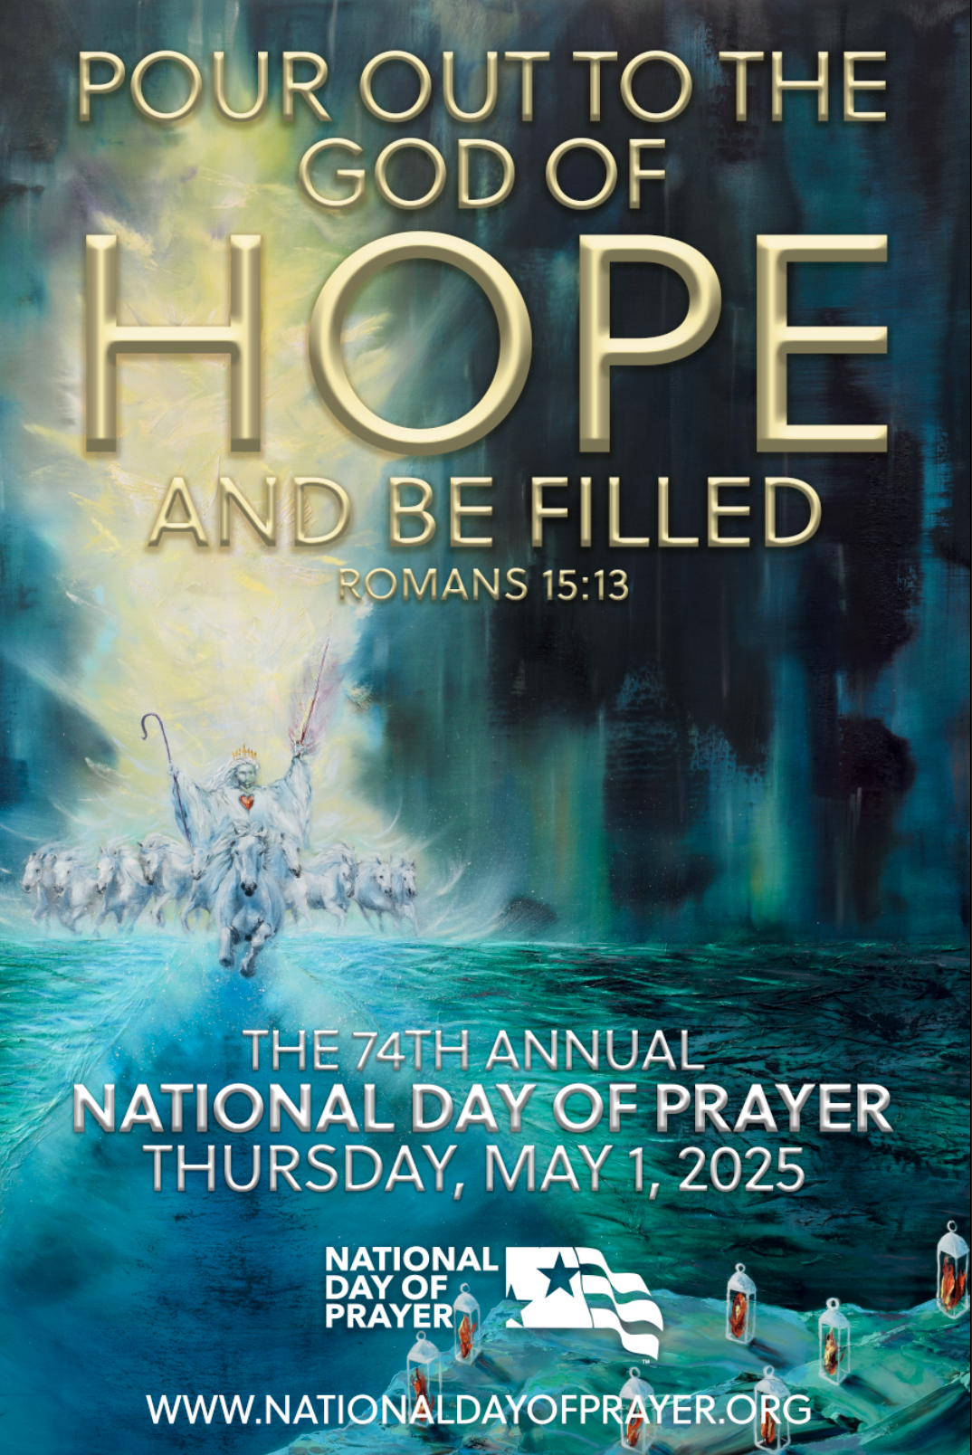
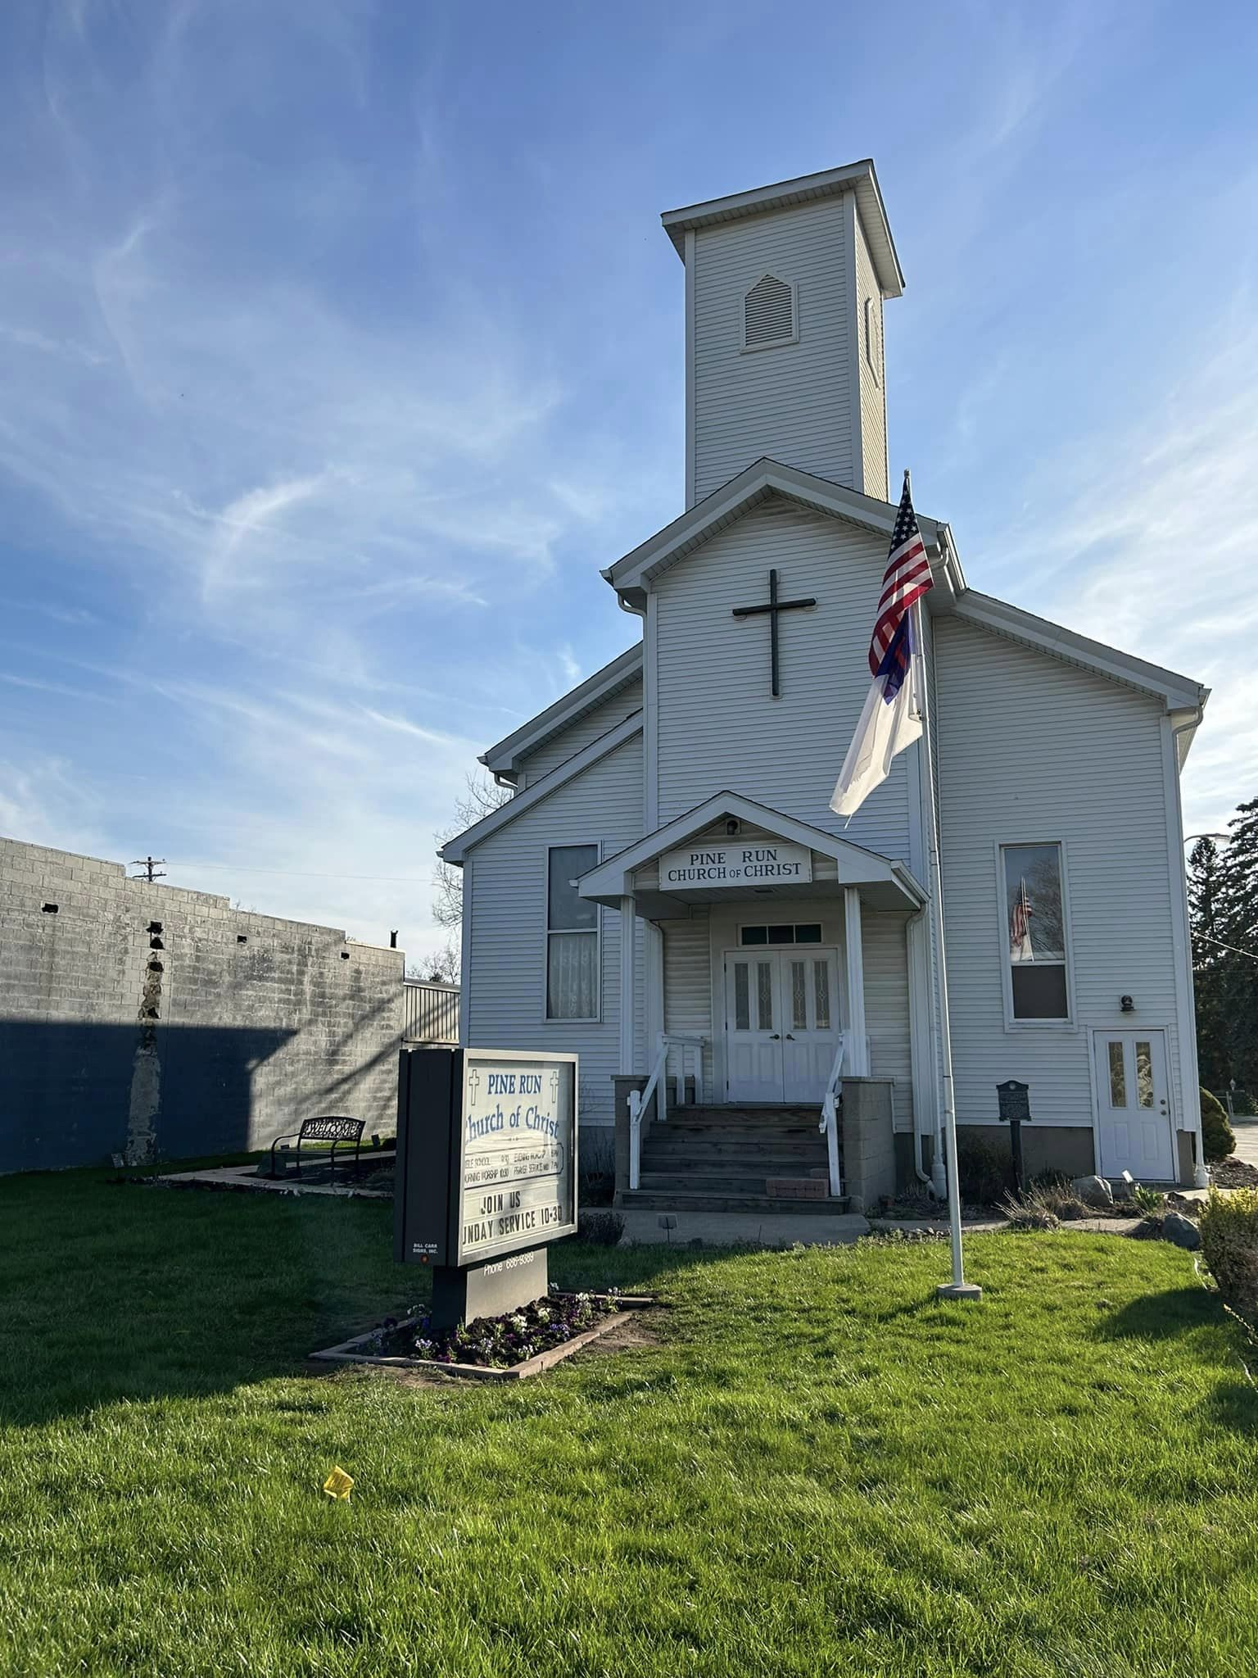
Prayer for
Gatherings

Slide 2
Areas of Emphasis:
Church
Family
Education
Business/Workplace
Military
Government
Arts, Entertainment @ Media

Slide 3
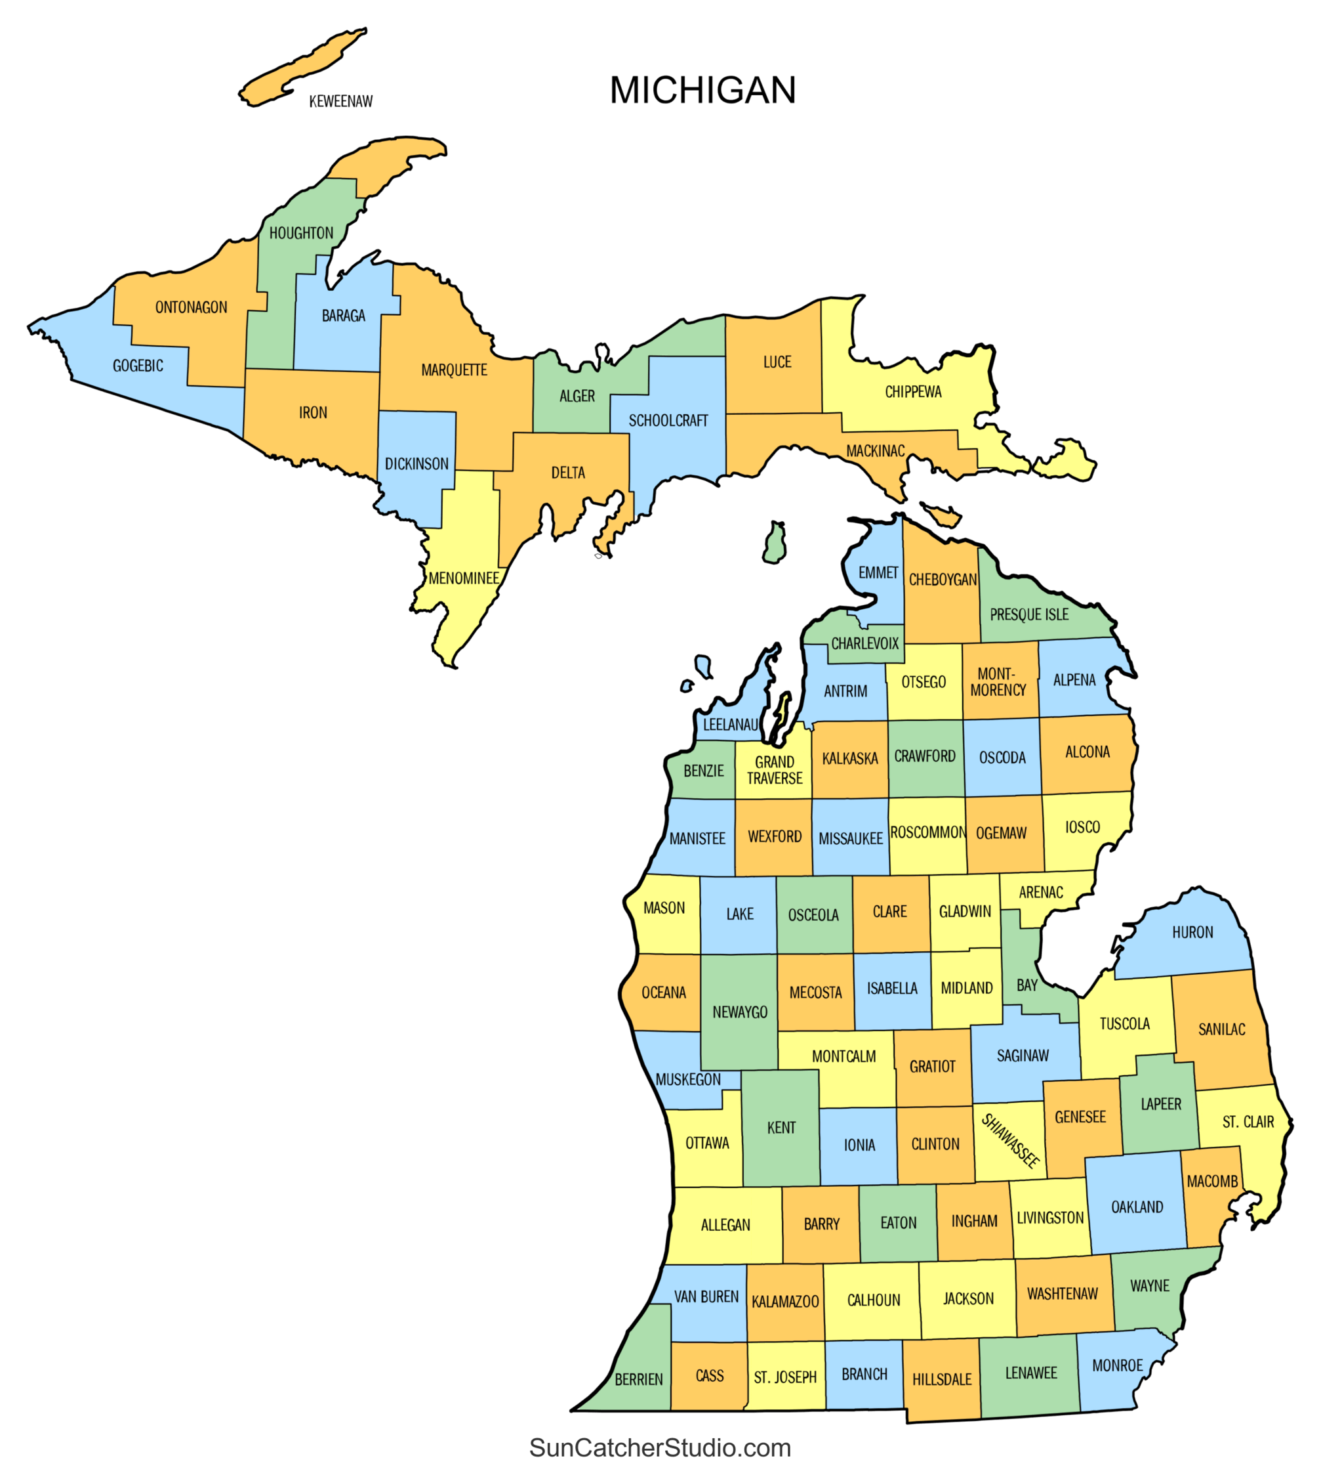
Around Michigan
Over 120 Meetings!
(We had part in helping establish several new through our
PRAYER WARRIORS--- Over 10% of all gatherings are in
communities we targeted)
(If other counties duplicated our results; nearly 500 meetings
would be held)
Capital: 2 Opposition Gatherings being held
  (Strategy being used in State Capitals throughout the Nation)

Slide 4
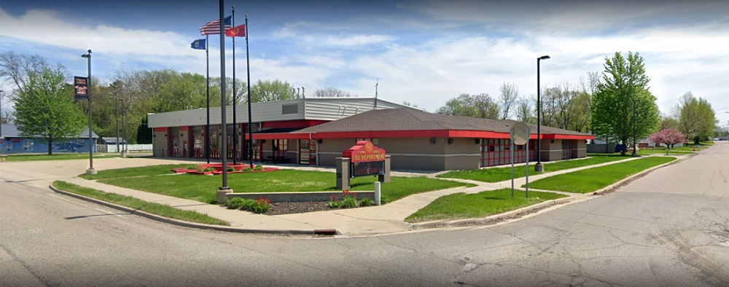
Clio-- Noon
NEW: YOUTH Prayer Breakout Group
ADDITIONAL EMPHASIS: World

Slide 5
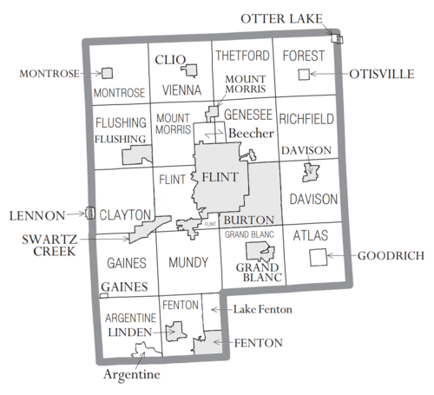
Genesee County
Flint Prayer Breakfast First Wesleyan 9:00 am
Montrose Township Hall Noon
Mt Morris Trinity Assembly of God
Burton CenterPoint Church 1:00 pm
Flint Around Flagpole First Wesleyan 6:00 pm
Otisville Vision Point Assembly of God 7:00 pm

Slide 6
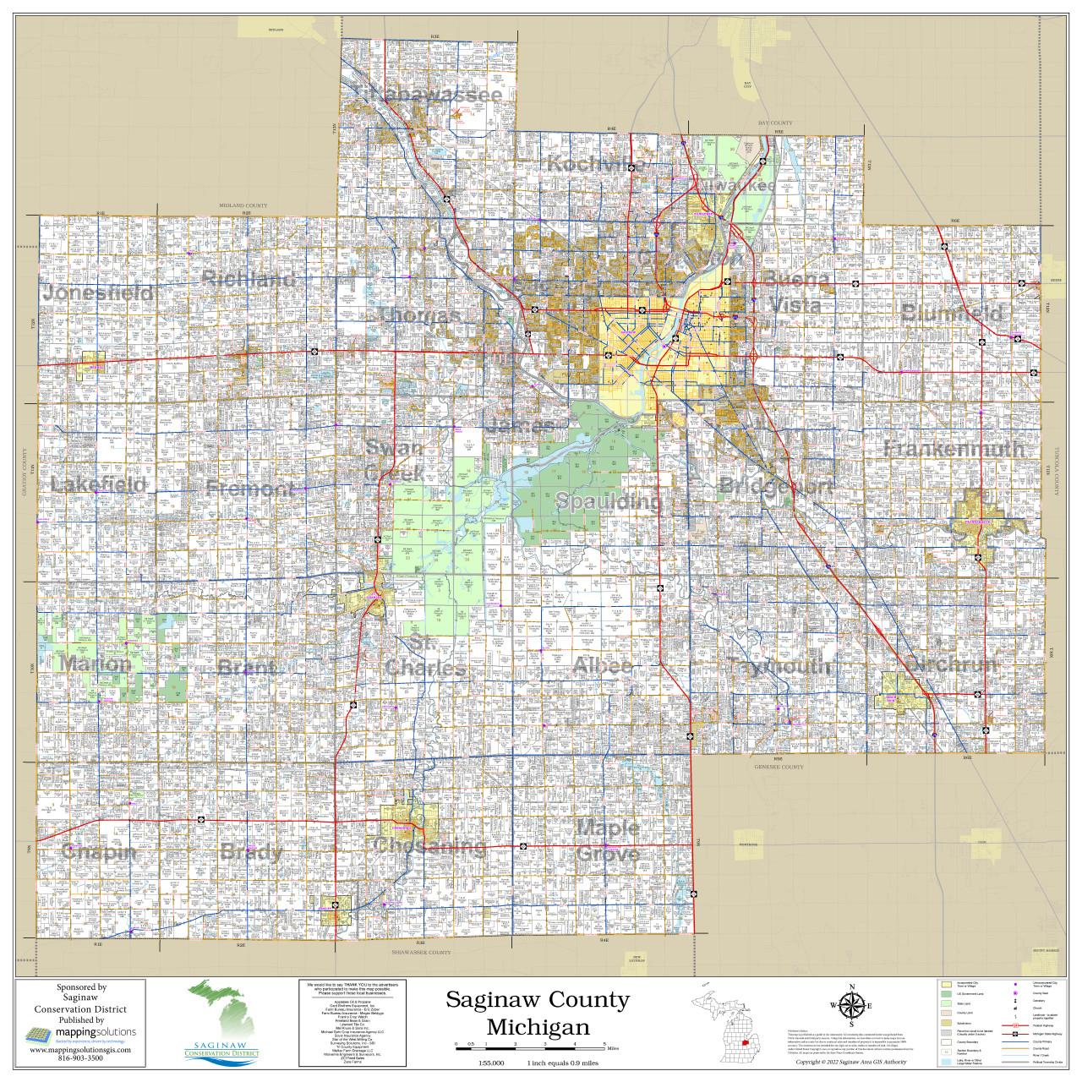
Saginaw County
Saginaw Good Shepherd 8:-8:45 AM
Saginaw Twp Saginaw Twp Fire Station Noon
Bay City City Hall Noon
Frankenmuth City Hall Front Lawn Noon
Midland County Courthouse Noon
Bridgeport Community Church 7:00 pm

Slide 7

Other Nearby Communities
Millington Millington High School
Vassar Vassar Victory Center 7:00-8:30 pm
SAGINAW COUNTY COORDINATOR recently appointed:
    Paul St. Louis Pine Run Church Clio

Slide 8

Targeting: Flint - Saginaw
Unite Believers
  Prayer
  Addressing Needs
    Clean Up Efforts by Christians in Flint & Saginaw
Develop Influence with Government Officials
Develop Influence with Business Leaders
Develop Influence with School Districts

Slide 9
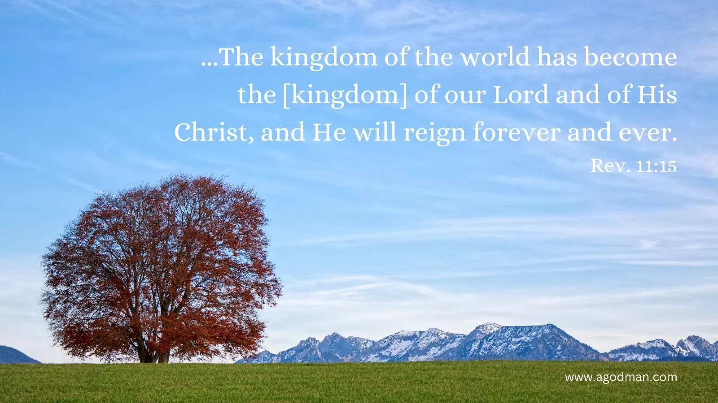
Prayer
Service
Evangelism
Discipleship
Praise & Worship

